Slide 1
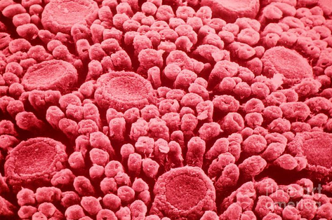
Taste!
Aka Gustation

Slide 2
Papillae
Filiform- no taste buds
Fungiform- tip and sides, only a few taste buds
Vallate- least numerous yet the largest, most taste buds found here
Foliate- not well developed, only a few taste buds during infancy and early childhood

Slide 3
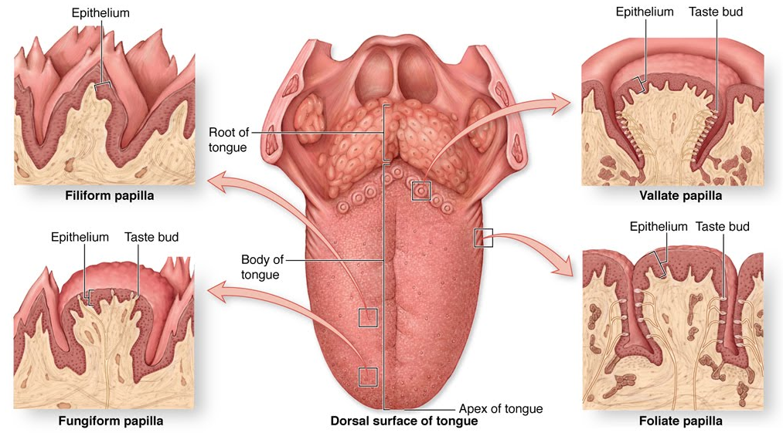
Papillae

Slide 4
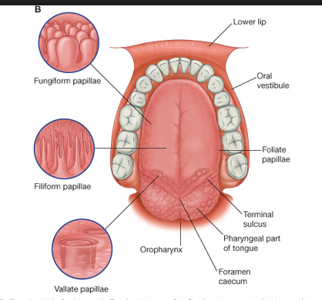

Slide 5
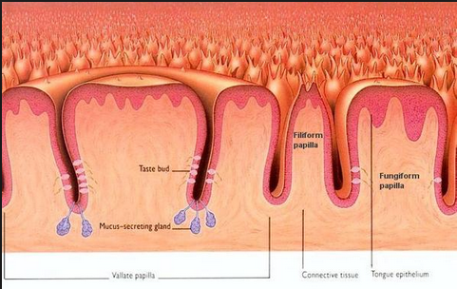

Slide 6
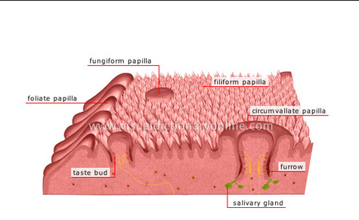

Slide 7
Structure of a Taste Bud
Taste bud
Gustatory cells (gustatory receptors) that are enclosed by supporting cells.
Gustatory cells have gustatory microvillus aka taste hair
Extends through opening in taste bud to the surface of the tongue
Saliva is required to break down food so that you can taste

Slide 8
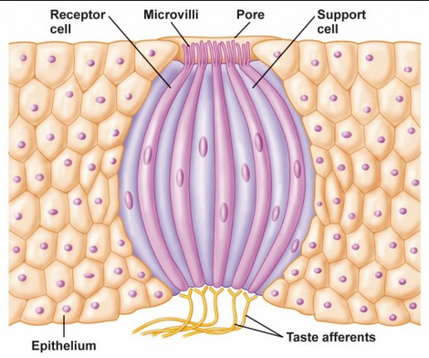

Slide 9
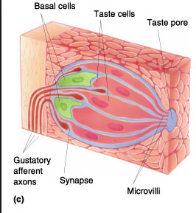

Slide 10
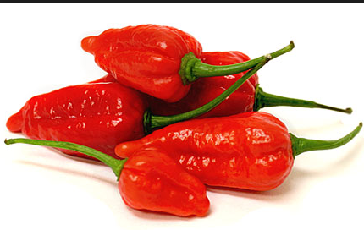
Age and Taste Buds
By age 50, our taste ability declines due to reduction in gustatory cell replacement and # of taste buds

Slide 11
Taste Sensations
Salty- caused by metal ions such as potassium or sodium
Sweet- organic compounds (ex. sugar)
Sour- H+ ions from acids
Bitter- caused by alkaloids, toxins, and poisons
Umani (savory)- amino acids such as glutamate and aspartate

Slide 12
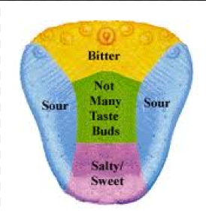

Slide 13
