Slide 1
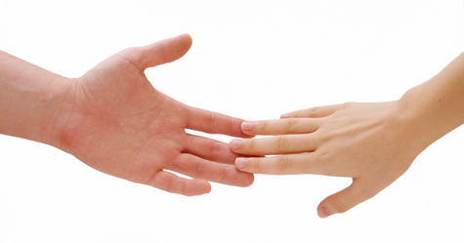
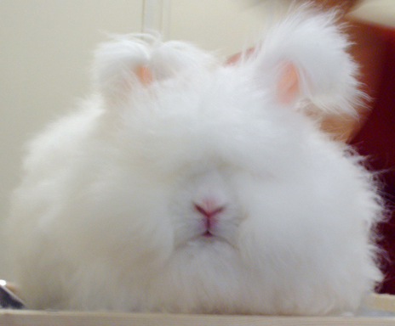
Somatic Senses

Slide 2
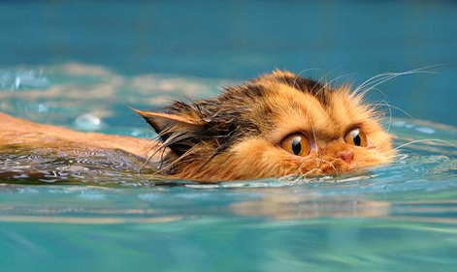
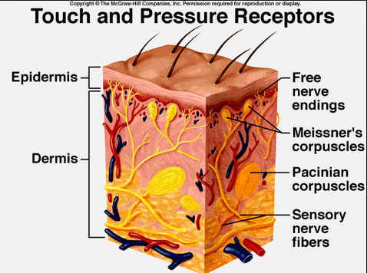
Receptors
Touch
Free nerve endings
Meissner’s corpuscles
Pacinian corpuscles
Temperature
Pain

Slide 3
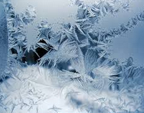
Temperature Sensors
Warm
77 to 113 degrees Fahrenheit
Unresponsive above 113 degrees
Pain receptors take over
Cold
50 degrees to 68 degrees Fahrenheit
Anything below triggers pain receptors= freezing feeling

Slide 4
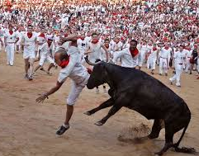
Pain Sensors
Consist of free nerve endings
None in brain
Sensitive to
Mechanical damage
Temperature
Chemicals
Blood deficiency
VERY LITTLE ADAPTATION…so pain lingers

