Slide 1
Sense of Smell

Slide 2
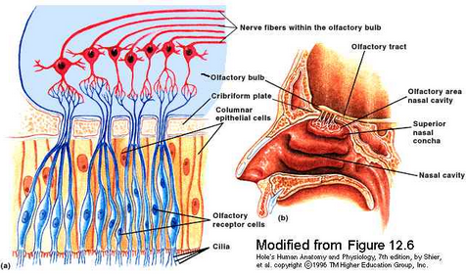
Olfactory Receptors
Chemoreceptors
Need liquid

Slide 3
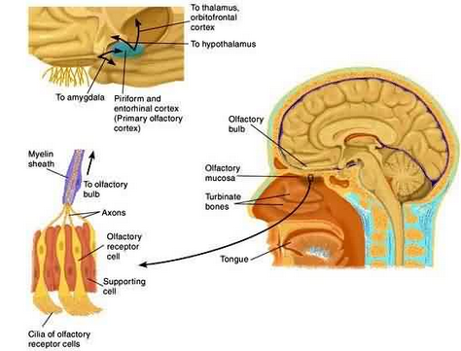
Olfactory Organs
= receptor cells and supporting cells
-Look yellow- brown
Receptor cells have cilia!

Slide 4
The Nose Knows….
Information is sent to limbic system
Emotions elicited
Receptor cells adapt quickly
Within a minute, might not smell the smell any more.
Mink must be an exception…ha!

Slide 5
Olfaction Comparative Anatomy
We have 12 million receptor cells
Bloodhounds have 4 billion
We have 1 ½ inches of olfaction area, bloodhounds have 59 inches

Slide 6
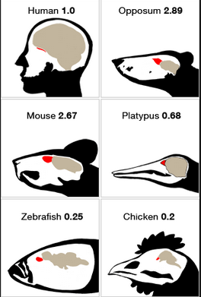

Slide 7
We can detect 10,000 smells!

