Slide 1
Daily Warm-up March 19th
What is the name of the enzyme that digests complex carbohydrates? What about the one that digests proteins?
HW:
-Read 31.1
Turn in :
-Homeostasis lab if haven’t already

Slide 2
What do you know about the nervous system?

Slide 3
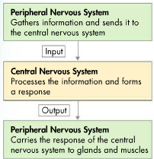
2 Systems
Central nervous system (CNS)
Brain, spinal cord
Processes information and forms response
Peripheral nervous system (PNS)
Sends information to CNS
Carries out response of CNS

Slide 4
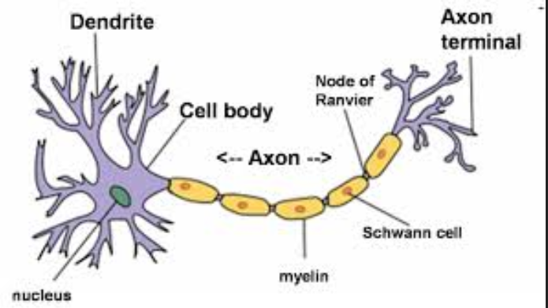
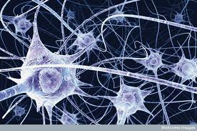
Neuron
Dendrite
Cell body
Axon
Myelin sheath

Slide 5
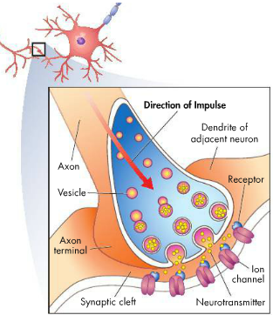
Synapse
Where two neurons meet
Neurotransmitters
Chemical signals

Slide 6
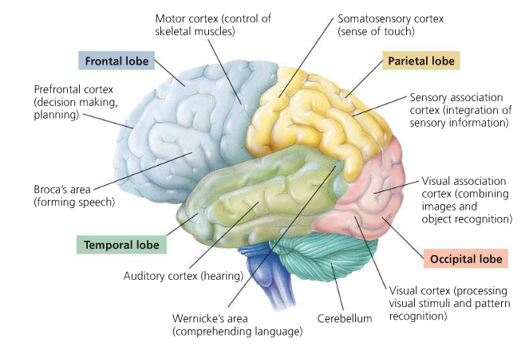
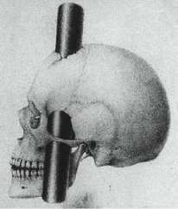
Brain & Functions

