Slide 1
Daily Warm-up Friday, October 31st
What is the proper classification of this image?
HW:
-Study for test
Turn in:
-Cell project

Slide 2
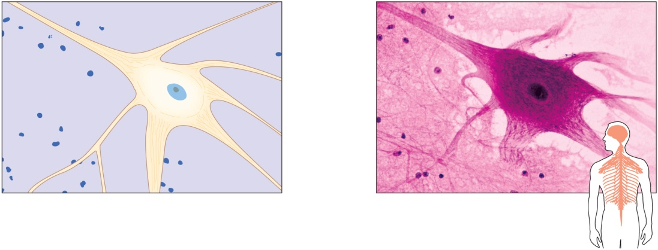
Nervous Tissue
Found in brain, spinal cord, and peripheral nerves
Functional cells are neurons
Copyright © The McGraw-Hill Companies, Inc. Permission required for reproduction or display.
Cellular
process
Neuroglial cells support and
bind nervous tissue components
Cytoplasm
Nucleus
Cell
membrane
Neuroglial
cells
Sensory reception
(a)
(b)
b: © Ed Reschke.
Conduction of nerve impulses

Slide 3
5.4: Types of Membranes
There are four (4) types of epithelial membranes:
1. Serous Membranes
Line body cavities that do not open to the outside
Reduce friction
Inner lining of thorax and abdomen
Cover organs of thorax and abdomen
Secrete serous fluid
2. Mucous Membranes
Line tubes and organs that open to outside world
Lining of mouth, nose, throat, etc.
Secrete mucus
3. Cutaneous Membranes
Covers body
Skin
4. Synovial Membranes
Composed entirely of connective tissue
Lines joints

Slide 4
Quiz!
Which type of membrane lines body cavities but does not open to the outside?
Serous
Mucous
Synovial

