Slide 1
Naming the Muscles
Location
Function
Shape
Fiber direction
Number of heads/divisions
Points of attachment
Muscle size

Slide 2
Location examples
Tibialis anterior
Rectus femoris

Slide 3
Function examples
Pronator quadratus

Slide 4
Shape examples
Trapezius
Deltoid

Slide 5
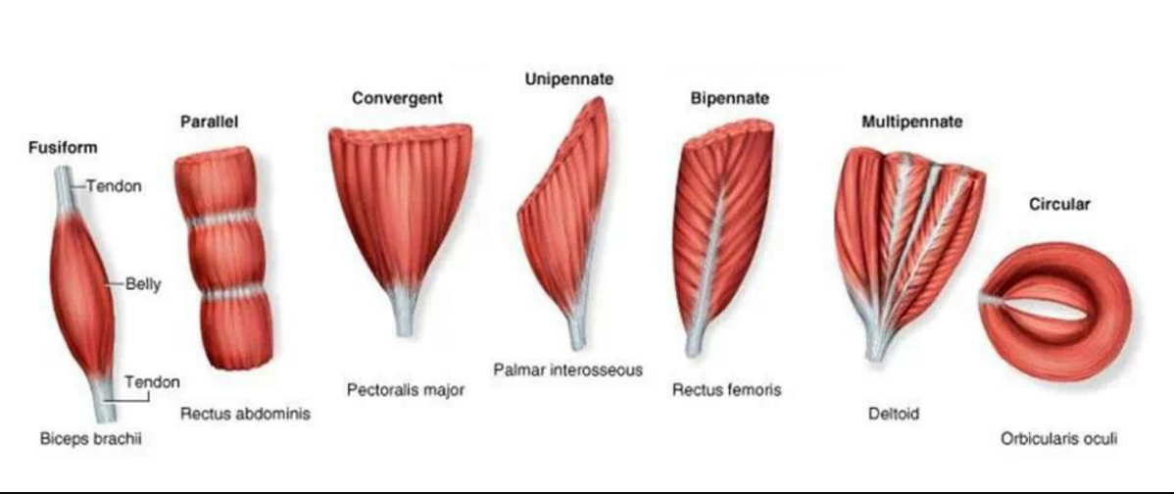
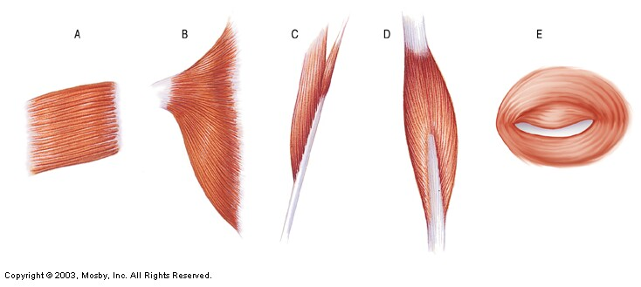
Muscle Fiber Arrangement
___________
___________
_________
___________
___________

Slide 6
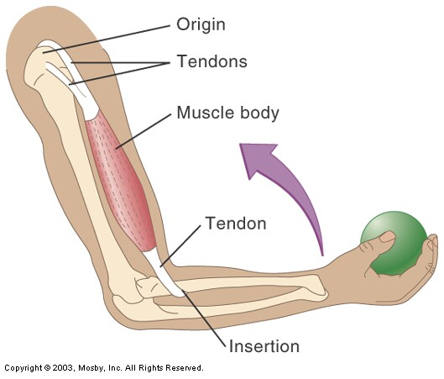
Muscle Attachment
Does NOT move when
muscle contracts
Does move when
muscle contracts

Slide 7
Location
Function
Frontalis | Frontal bone
Femoris | Femur
Gluteus | Posterior of hip/thigh
Oculi | Eye
Oris | Mouth
Radialis | Radius
Ulnaris | Ulna
Brachialis | Arm
Abductor | Moves part away from body
Adductor | Moves part toward body
Depressor | Lowers a part
Extensor | Extends a part
Flexor | Flexes a part
Levator | Elevates a part
Rotator | Rotates a part
Fiber Direction
Shape
Oblique | Diagonal to midline
Rectus | Parallel to midline
Sphincter | Circling an opening
Transversus | Right angle to midline
Deltoid | Shaped like delta ∆
Orbicularis | Circular
Platy | Flattened; platelike
Quadratus | Square
Rhomboideus | Diamond-shaped
Trapezius | Trapezoidal

Slide 8
Number of divisions
Bicep | Two heads
Tricep | Three heads
Quadricep | Four heads
Size
Brevis | Short
Longus | Long
Magnus | Large
Maximus | Largest
Medius | Moderately sized
Minimus | Smaller

Slide 9
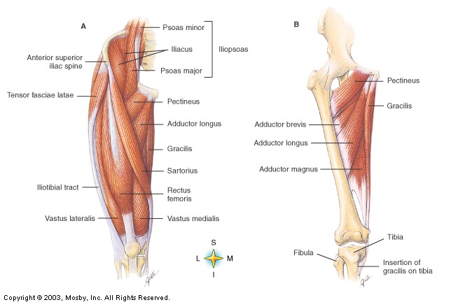
Upper Leg
Deep muscle
Vastus intermedius
Biceps femoris
Semimembranosus
Quadricep
Femoris
Semitendinosus

Slide 10
Classification of Muscle Group Actions
Agonist (Prime Mover)
Muscle most responsible for movement
Antagonist
Opposes prime mover
Provides precision and control during prime mover contraction
Relaxes when prime mover contracts
Synergist
Aid prime mover
Contract at same time as prime mover

