Slide 1
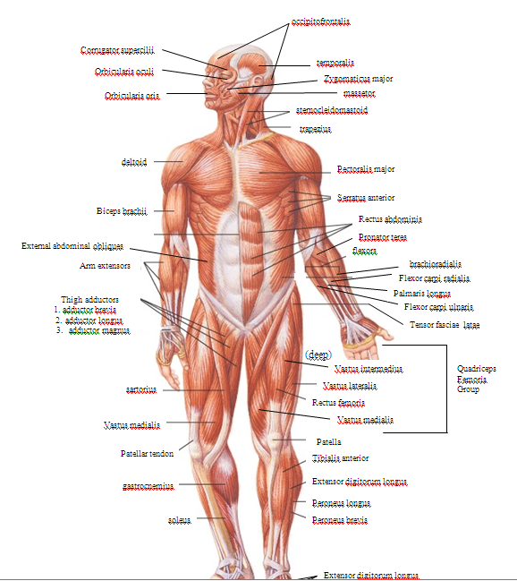
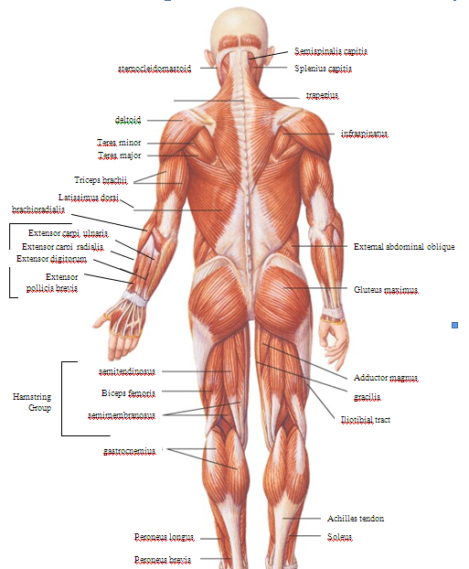

Slide 2
Types of Muscle
Skeletal
Striated
Voluntary
Multinucleated
Smooth
Non-striated
Involuntary
Cardiac
Striated
Involuntary
Intercalated disks
~ 50% of body weight
Work in groups to perform a function

Slide 3
General Functions of Muscular System
Movement
Heat Production
Posture
Continued partial contraction of muscle in order to perform many functions

Slide 4
Characteristics of all Muscles
Excitability
Respond to stimuli
Contractility
Actively shorten to exert a pull
Tension that can be harnessed
Extensibility
Continue to contract over range of resting lengths
Ex: smooth muscle can be stretched to several times its original length and still contract on stimulation
Elasticity
Return to original length after contraction

Slide 5
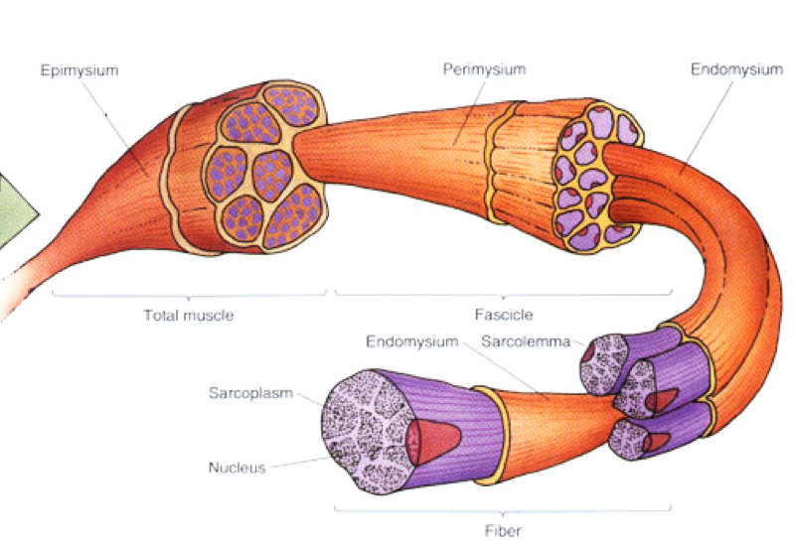
Muscle Microanatomy

Slide 6
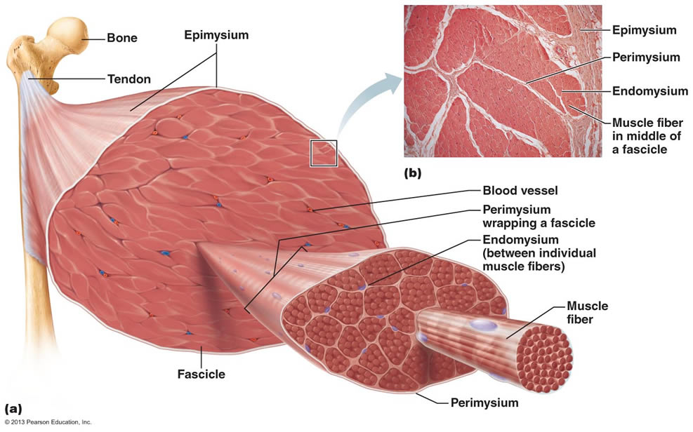
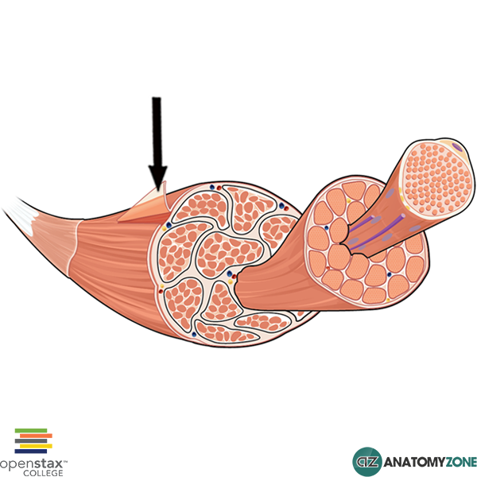
The Coverings
Epimysium is CT that covers the entire muscle

Slide 7
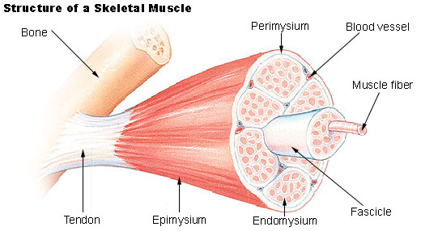
Coverings continued
Perimysium covers a fascicle
A fascicle is a bundle of muscle cells aka muscle fibers

Slide 8
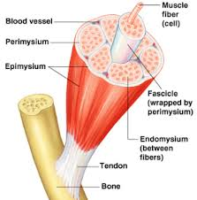
Coverings continued
Endomysium- covers a muscle cell aka muscle fiber

Slide 9
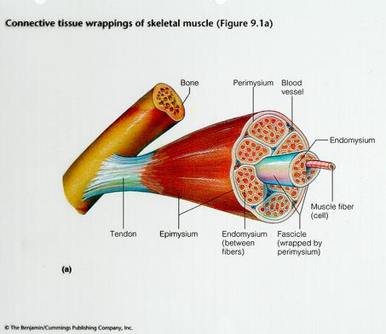

Slide 10
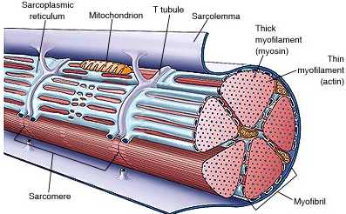
The parts of a muscle cell
Sarcolemma- plasma membrane
Sarcoplasmic reticulum- endoplasmic reticulum
Sarcoplasm- cytoplasm
Myofibrils= rod-like
unit. Have sarcomeres

Slide 11
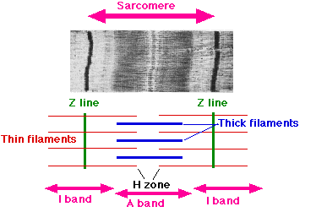
Going further….the Sarcomere
Dark bands are “A bands”
Thick filaments (myosin) and thin filaments (actin)
Light bands are “I bands”
Thin filaments (actin)

Slide 12
Still further with the Sarcomere
H Zone
Found within the Dark band, made up of only thick filament (central region of the Dark)
Z lines- create the boundary of each sarcomere. Formed by connection of actin filaments to each other

Slide 13
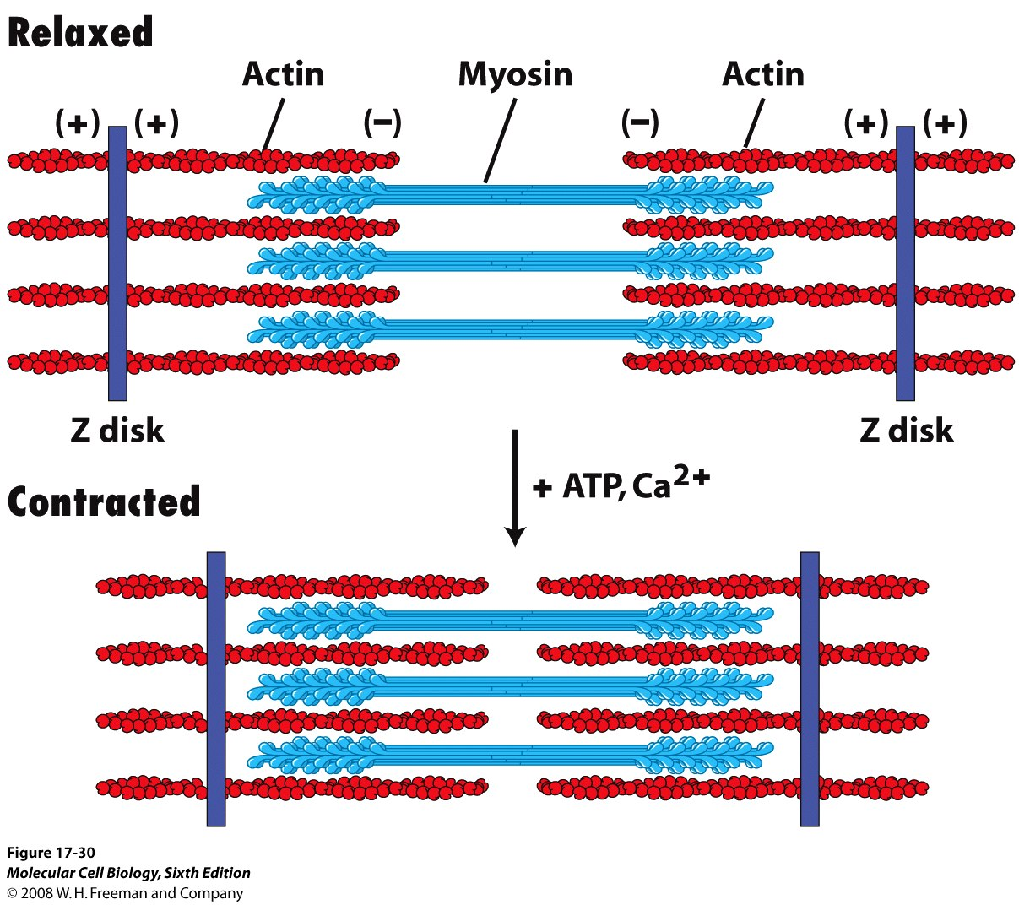

Slide 14
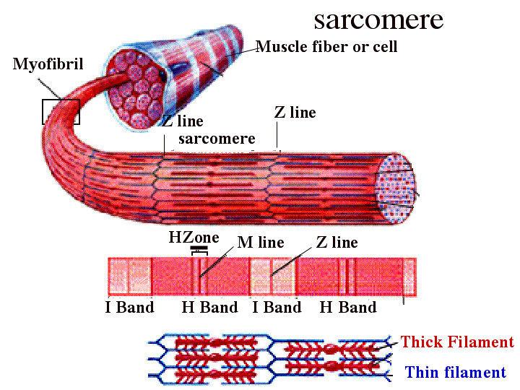

Slide 15
Muscle Contraction
Requires:
sarcoplasmic reticulum- produces calcium ions
transverse tubules- tubes that connect SR deeper into the cell and aid in conducting the signal
Happens because a motor neuron releases the neurotransmitter, acetylcholine (Ach), into the synaptic cleft

Slide 16
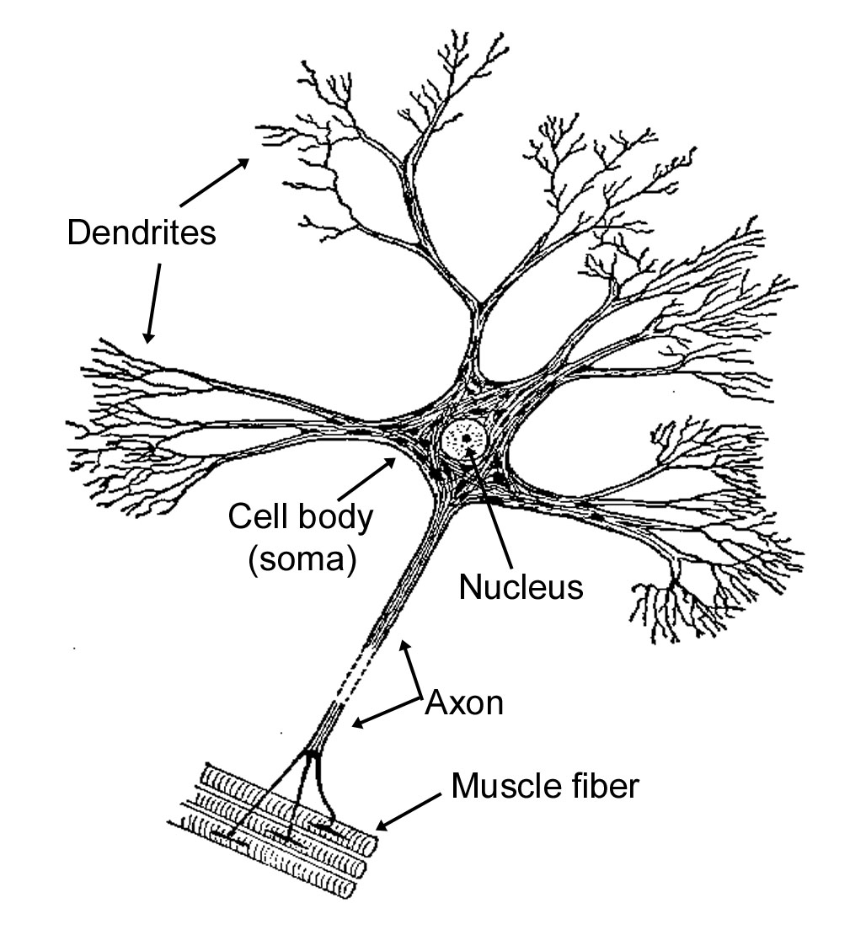

Slide 17
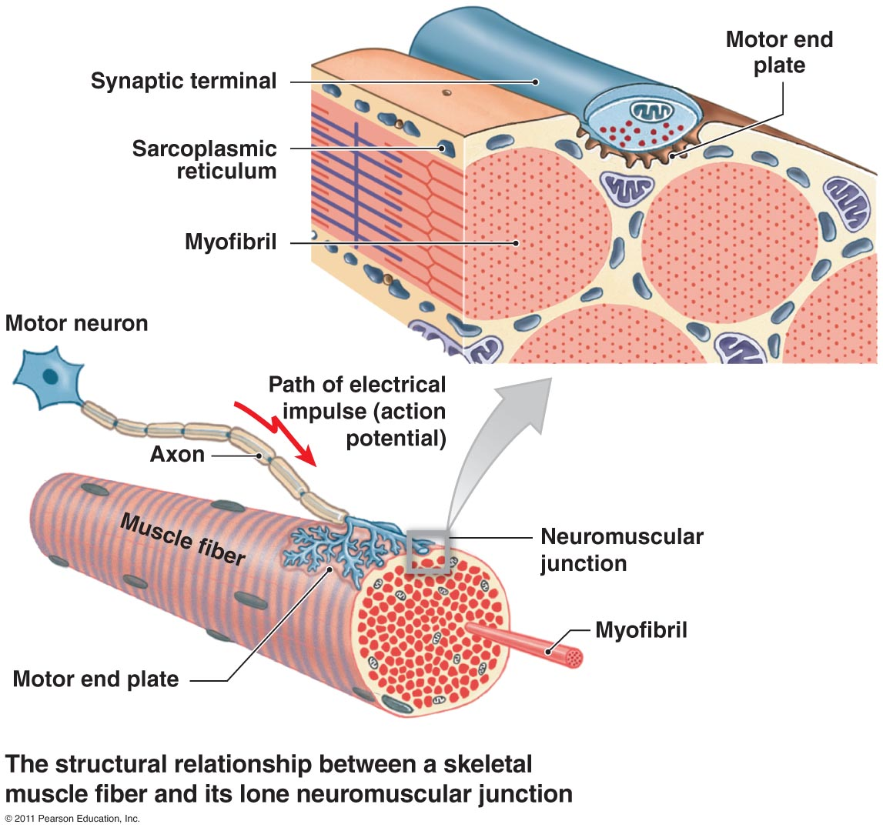

Slide 18
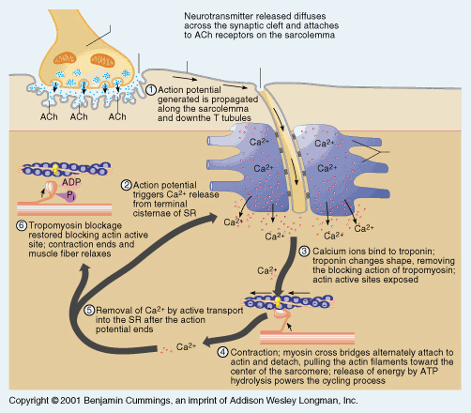

Slide 19
Action Potential!
Absolutely necessary for a muscle to contract
Acetylcholine is released by a motor neuron
Acetylcholine bonds to receptors in the sarcolemma
The receptors open, allowing Na+ to flow into the area, temporarily causing it to become positively charged
A wave reaction opens as the local positive charge allows the next gate to open.
The action potential continues down the T-tubules to the sarcoplasmic reticulum
The positive charge allows calcium to be released from the SR
Calcium binds to troponin (one blocker against myosin)
Troponin removes tropomyosin (the other blocker)
Myosin is able to bond with actin in a stroke-like motion with the aid of ATP
Another ATP molecule is used to put myosin back in relaxed state

Slide 21
Rigor Mortis
No more ATP to release myosin
After 16-24 hours, rigor mortis disappears due to the muscle proteins dissolving

