Slide 1
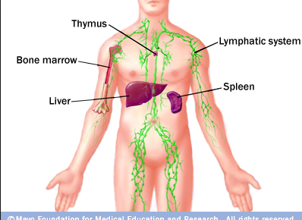
Lymphatic System

Slide 2
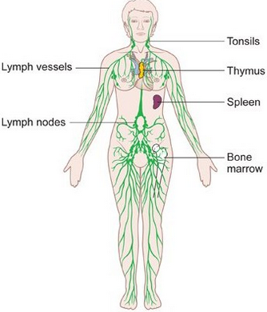
What is it?
= Immune system
-Works closely with the cardiovascular system
-Separate lymph capillaries and vessels
-Functions
-Immunity
-Transport of fluids
-Transport of fats

Slide 3
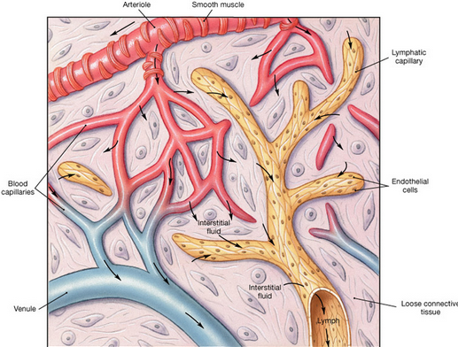
Lymphatic Pathways
Capillaries-> Vessels-> Veins in thorax
Lymphatic capillaries
Collect extra fluid in the tissues and returns to circulatory
Lymphatic vessels
Thinner than veins

Slide 4
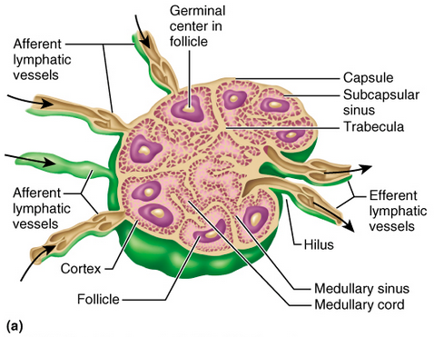
Lymph vessels lead to….
Lymph nodes

Slide 5
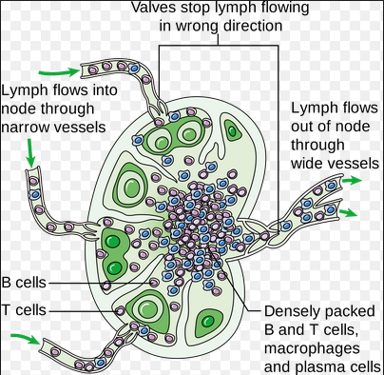

Slide 6
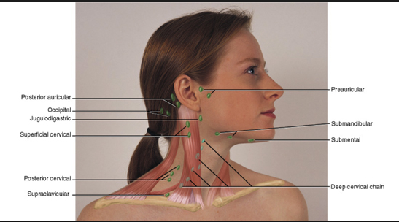

Slide 7
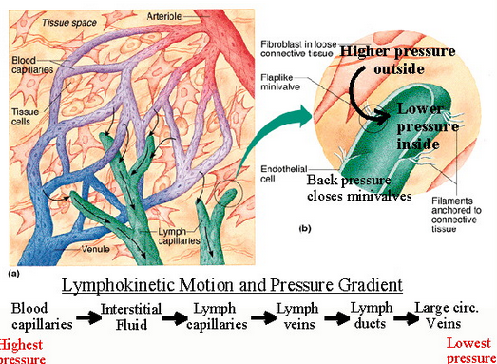
Lymph
Tissue fluid
Very similar to plasma (just without as many proteins)
Enters via osmosis and diffusion

Slide 8
Movement of Lymph
Hydrostatic pressure
Muscular movement
Flow peaks during exercise
Blockages- edema (swelling because of fluid build-up)

Slide 9
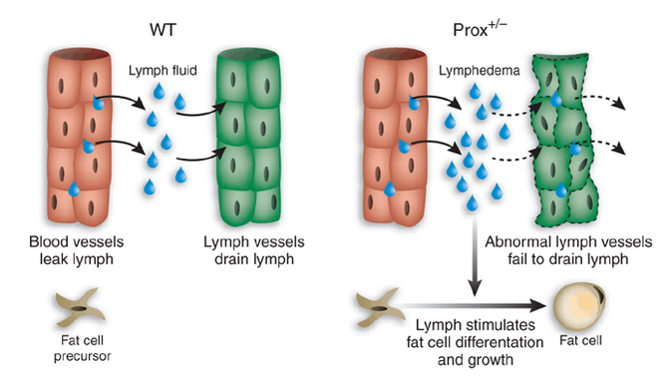

Slide 10
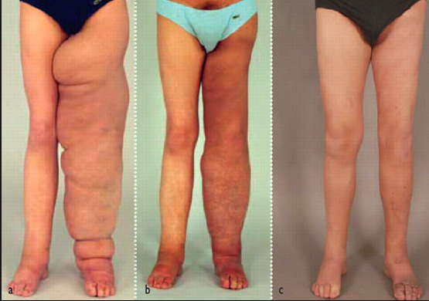

Slide 11
Importance of Lymph Nodes
Contain large number of lymphocytes and macrophages
Besides the nodes, two important players: the spleen and thymus

Slide 12
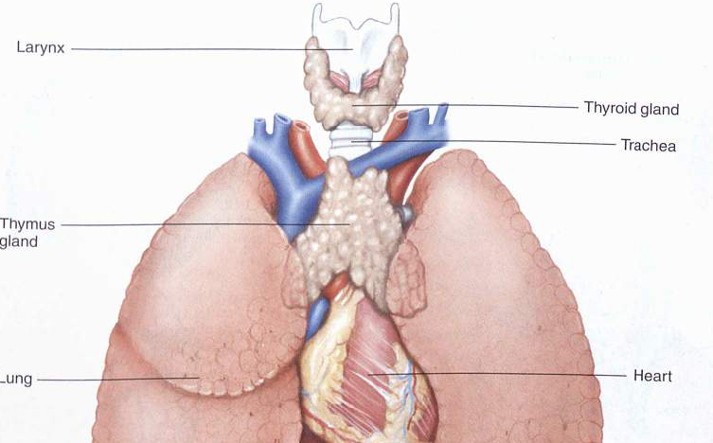
Thymus
Produce t-cells

Slide 13
Spleen
Largest lymphatic organ
-Cleansing of old red blood cells

Slide 14
Body Defenses Against an Infection
Pathogen
Innate (nonspecific) vs. Adaptive (specific)

