Slide 1
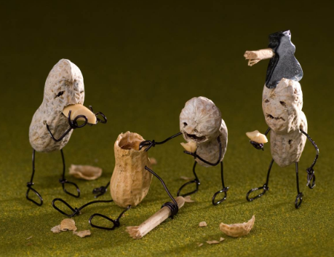
Lobes of the brain

Slide 3
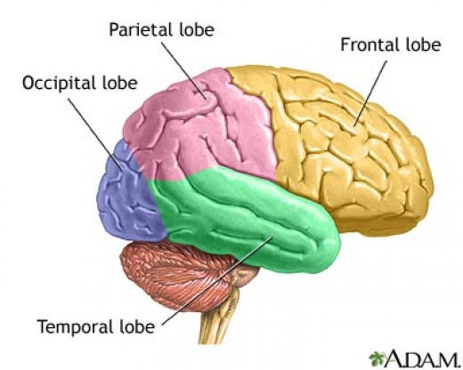

Slide 4
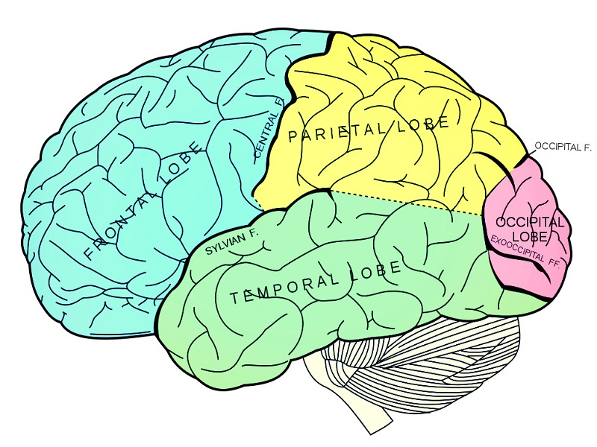
Frontal lobe
Voluntary motor actions
Concentration
Verbal communication
Decision-making
Planning
Personality

Slide 5
Parietal lobe
Sense of pain, touch, temperature
Distinguishing size, shape, and color
Spatial perception
Visual perception

Slide 6
Temporal lobe
Speech (understanding language)
Memory
Hearing
Sequencing
Organization

Slide 7
Occipital lobe
Vision

Slide 8
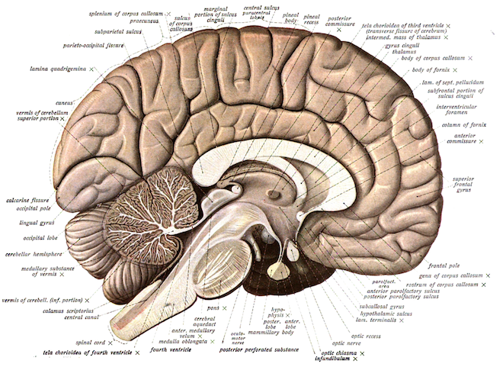
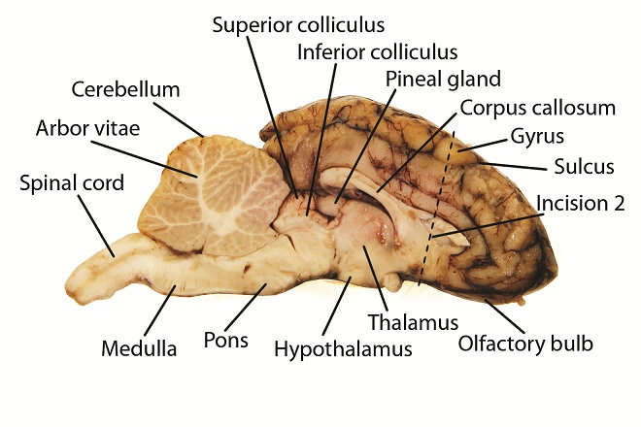
Cerebellum
Coordination and balance

Slide 9
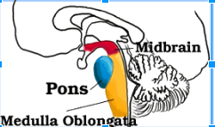
brainstem
Medulla Oblongata
Breathing, heart rate
Pons
Breathing, sensory and visual analysis
Midbrain
Auditory and visual analysis, involuntary muscle movement

Slide 10
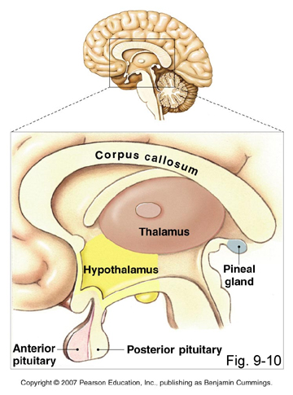

Slide 11
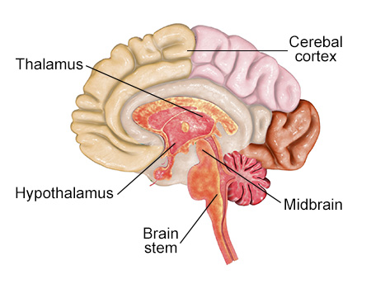
Thalamus
Sensations
Conscious recognition of pain, temperature, touch
Relay sensory info (except smell) to cerebrum
Emotions of pleasant and unpleasantness
Complex reflexes

Slide 12
hypothalamus
Regulates and coordinates autonomic activities
HOMEOSTASIS

Slide 13
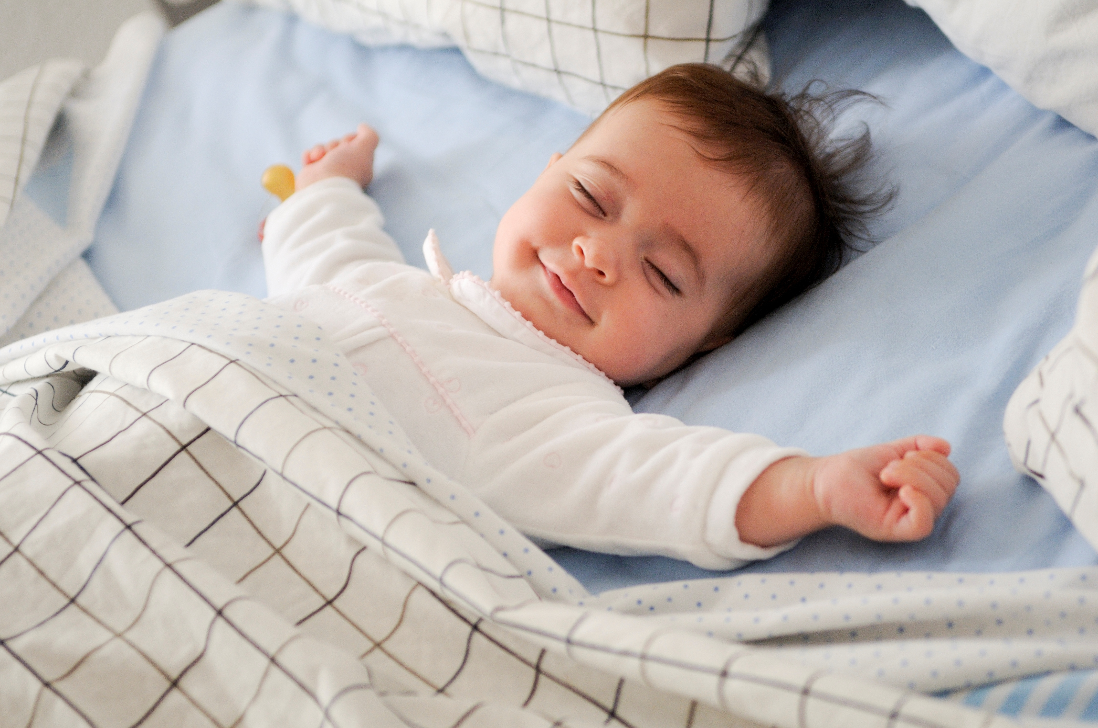
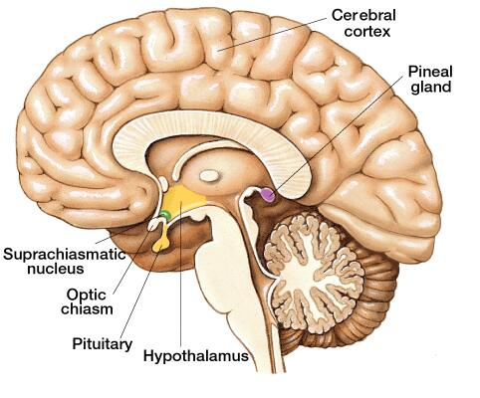
Pineal gland
Biological clock
Production of certain hormones
Ex. Melatonin

Slide 14
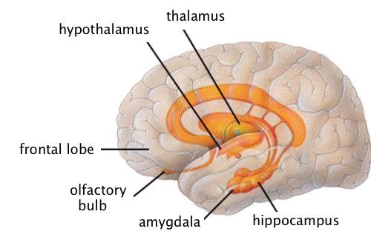
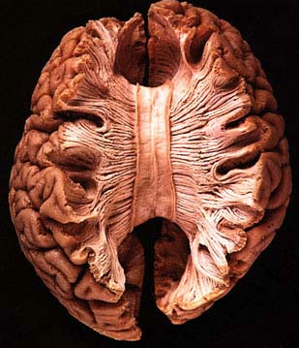
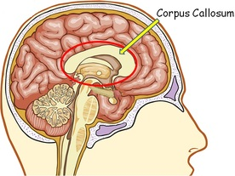
Limbic system
Hypothalamus
Thalamus
Hippocampus
Long-term memory
Amygdala
Reward, fear, mating
Corpus callosum
Connects the hemispheres

Slide 16
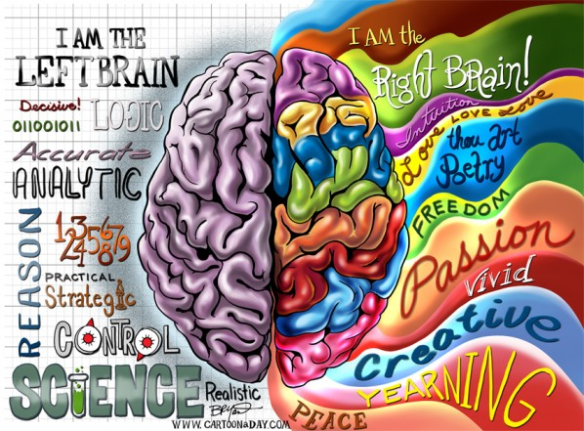

Slide 18
