Slide 1
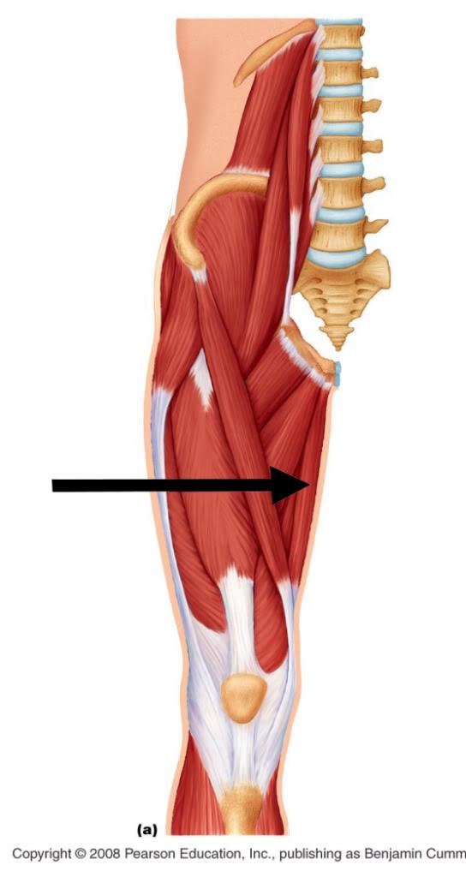
Gracilis
Helps to adduct
Assists in flexing the knee

Slide 2
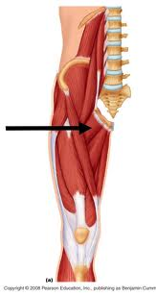
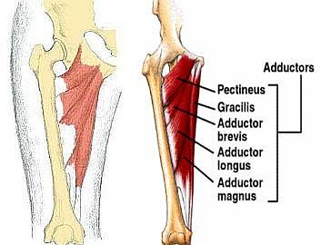
Pectineus

Slide 3
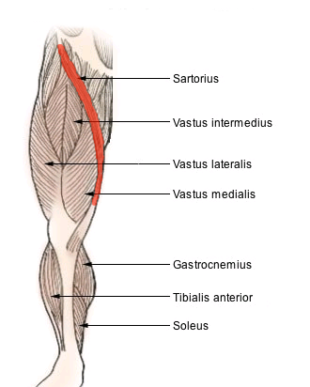
Sartorius
Flexes
Rotates hip
Abducts

Slide 4
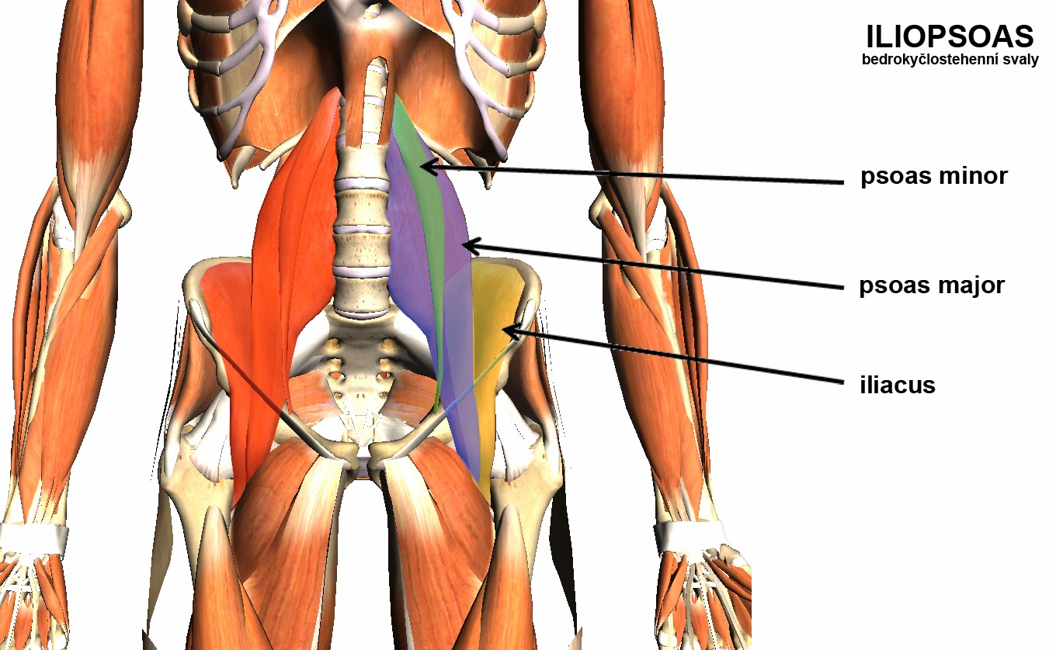
Iliopsoas…psoas
Hip flexor

Slide 5
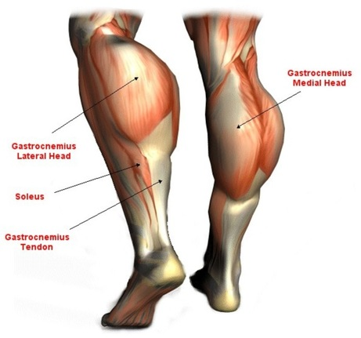
Gastrocnemius
Plantar flexion

Slide 6
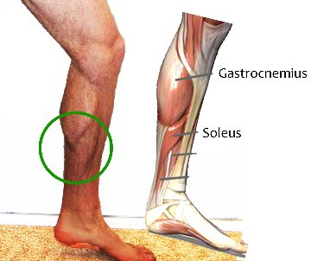
Soleus
Plantar flexion

Slide 7
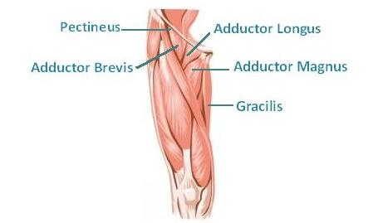
Adductors

Slide 8
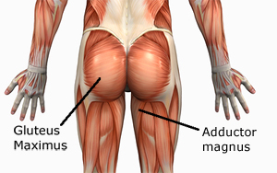
Gluteus Maximus

Slide 9
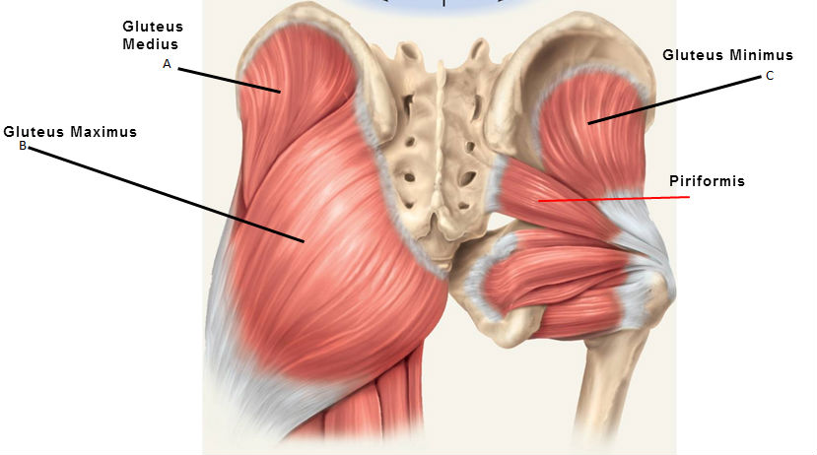
Gluteus Medius
Abduct the leg

Slide 10
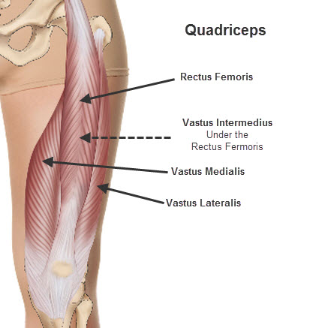
Quadriceps
Extensor of the lower leg

Slide 11
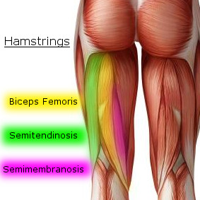
Hamstrings
Extension of hip
Flex knee

Slide 12
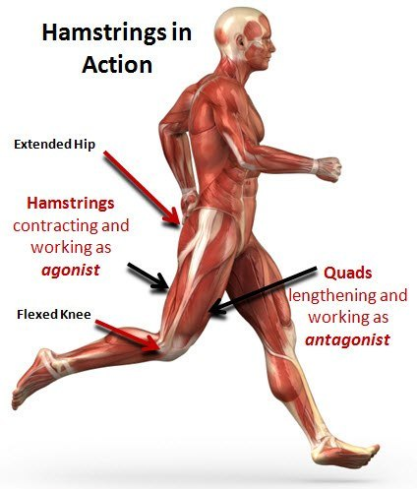

Slide 13
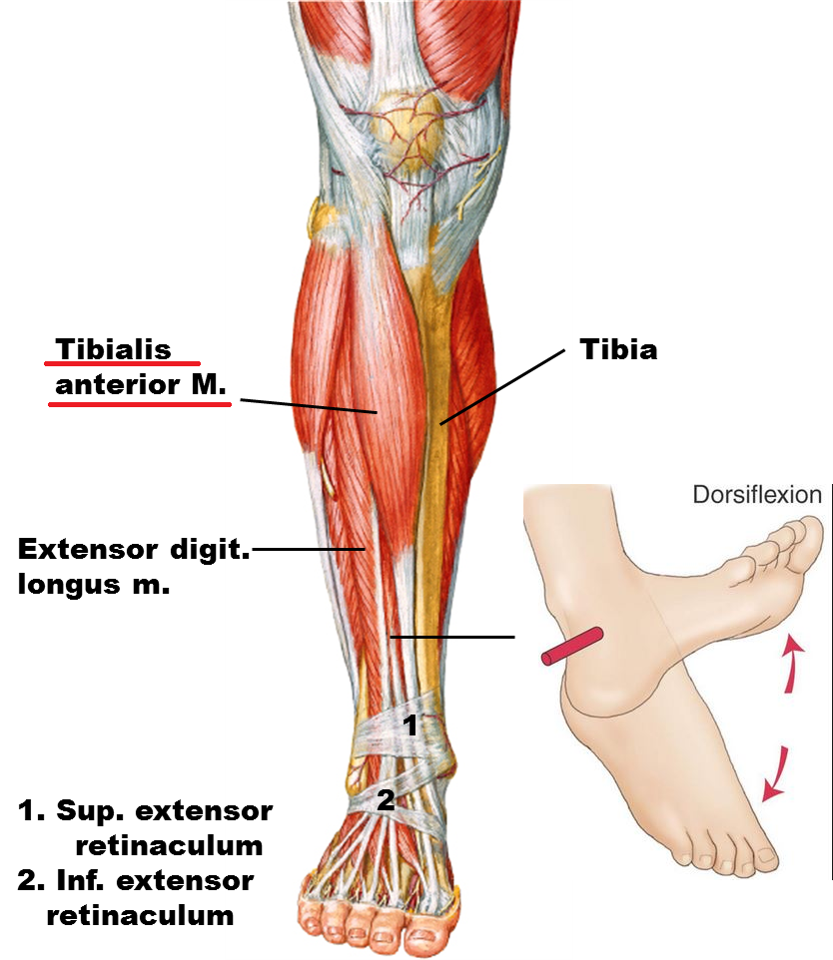
Tibialis Anterior

