Slide 1
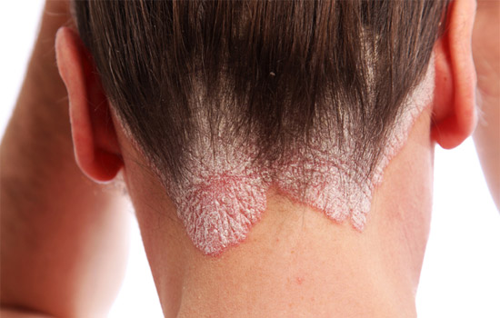
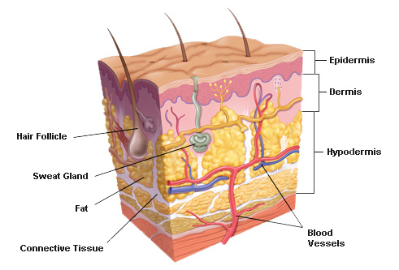
Integumentary System

Slide 2
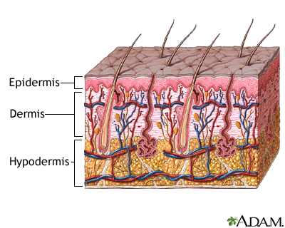
Skin!
Body’s largest organ
Consists of two layers: epidermis and the dermis

Slide 3
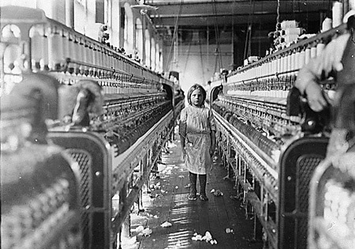
Functions
Protection
Prevention of water loss
Temperature regulation
Metabolic regulation
Immune defense
Sensory reception
Excretion

Slide 4
Epidermis
-Outermost layer
-Stratified squamous epithelial cells
Avascular!
-Basement membrane separates the epidermis from the dermis

Slide 5
Epidermis continued
5 layers
-Stratum basale
Attached to basement membrane
Get enough nourishment to grow and divide
*As move towards top layers, cells begin to undergo keratinization

Slide 6
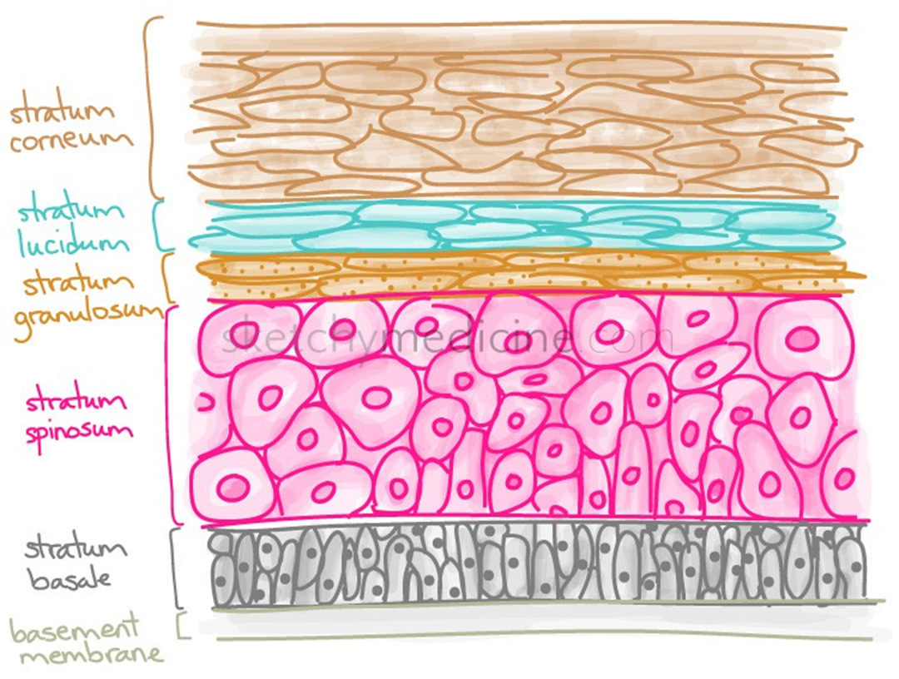

Slide 7
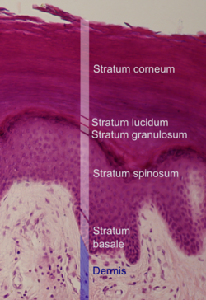

Slide 8
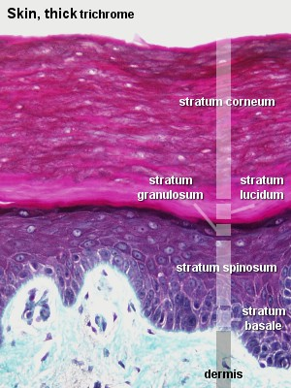
Epidermis layers continued
Stratum spinosum
Stratum granulosum
Stratum lucidum
Stratum corneum
-Top-most layer
-Dead cells filled with keratin for protection
-Cells eventually shed
Thickest on soles and palms (0.8-1.4 mm thick)

Slide 9
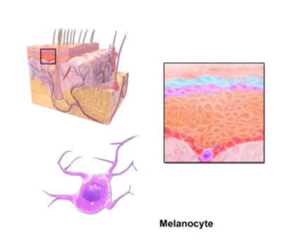
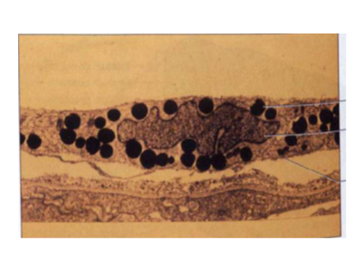
Specialized epidermal cell= Melanocyte!
Produces granules of melanin
Skin tone!
Absorbs UV light to protect

