Slide 1
Daily Warm-up March 24th
What are the phases of mitosis? During which phase do chromosomes line up in the middle of the cell?
HW:
-Wanted Poster due Friday
-Read 35.1
Turn in:
-Nothing

Slide 2
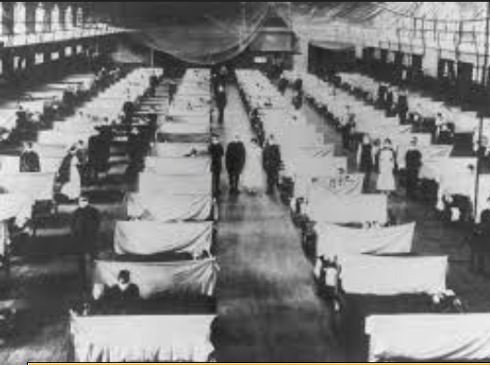
Immune System
What do you know?

Slide 3
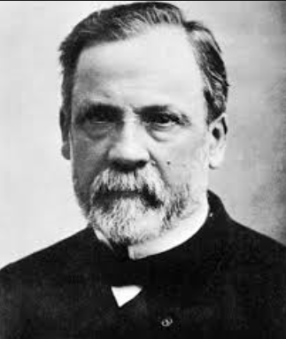
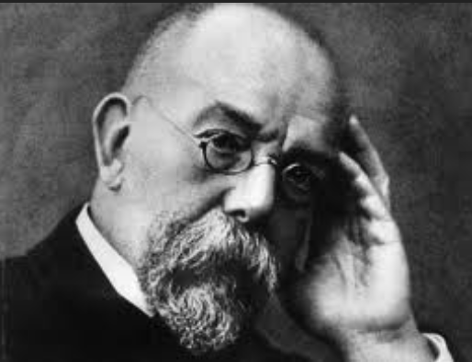
Germ Theory

Slide 4
Koch’s Postulates & Medicine
Pathogen must be found in sick organism
Pathogen must be isolated and grown in pure culture
When cultured pathogen is introduced should cause same disease
Injected pathogen must be isolated from the second and be identical
*** Help identify disease***

Slide 5
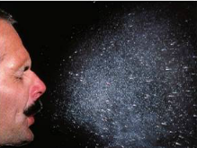
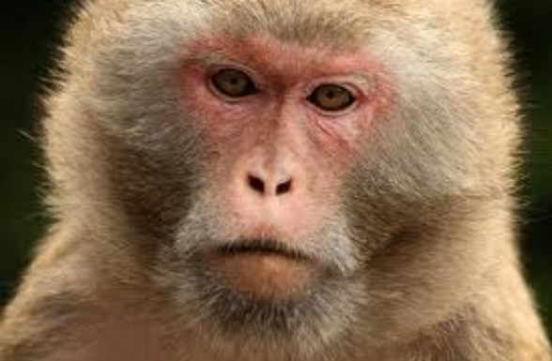
How are Diseases Spread?
Coughing, sneezing, physical contact, exchange of body fluids, contaminated water, food, infected animals
Zoonosis- disease that can be
transmitted from animal to human
-Animal is a vector or carrier
if do not get sick

Slide 6
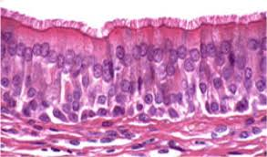
Immune system & Nonspecific Defense
Wide variety of pathogens
First line of defense:
Barriers
Skin, stomach acid, lysozyme, cilia on cells
Second line of defense:
Inflammatory response
Interferons
Fever

Slide 7
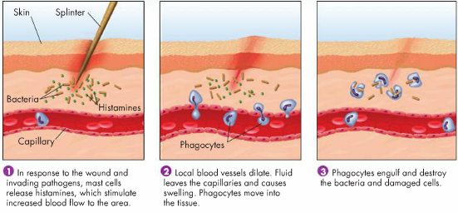
Inflammatory Response

Slide 8
Daily Warm-up March 25th
What is one example of the secondary line of defense with the nonspecific response?
HW:
-Read 35.2
-Poster due Friday

Slide 9
Immune System & Specific Defense
Response to a specific pathogen
How recognize self?
Molecular recognition- proteins on surface of cell

Slide 10
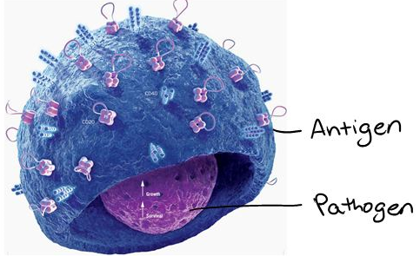
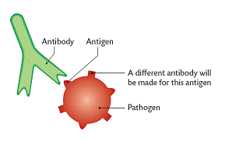
Specific Response
Antigens- any foreign substance that causes immune response- can be on pathogen or free-floating

Slide 11
2 Types of Adaptive/Specific Immunity
Humoral
-Body fluids, pathogens roaming free
Cell-mediated
--infected cells of your body, pathogens within a cell (virus)

Slide 12
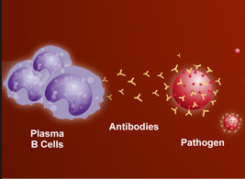
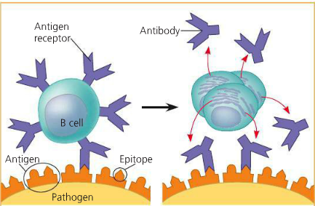
Humoral Response
B cells
Look for antigens in body fluids
If bind to pathogen- may become activated by helper T cell
Produce plasma cells and memory B cells
Antibodies!!!

Slide 13
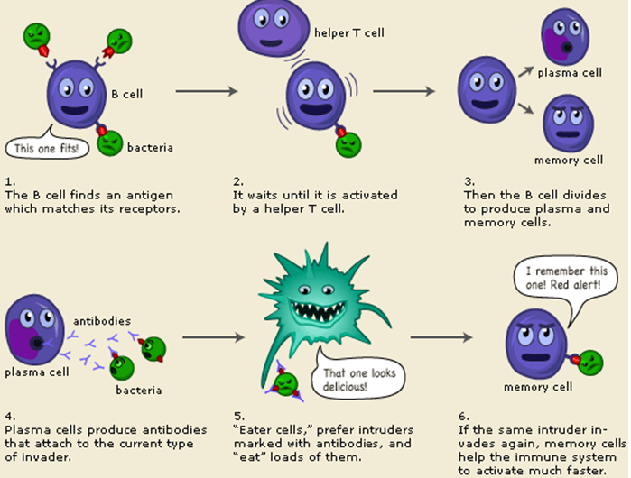

Slide 14
Cell-Mediated Specific Response
Cell-mediated
Infected cells sought out and destroyed
T cells
Helper T-cell
Activated when binds to white blood cells with antigen on surface
Activates B cells and cytotoxic T cells

Slide 15
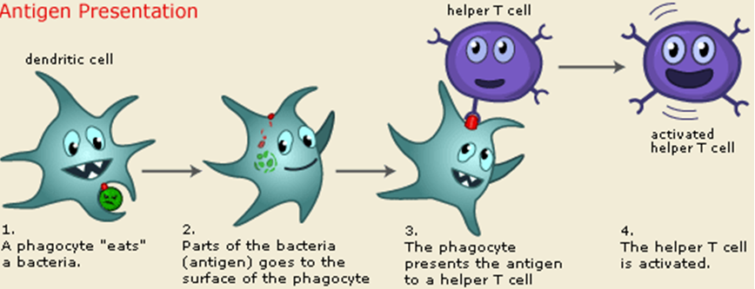

Slide 16
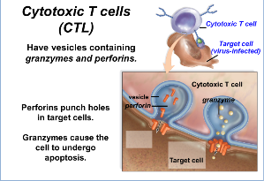
Cytotoxic T Cells
Kill any of your infected cells
Release chemicals to trigger cell death

Slide 17
Review
In HIV, helper T-cells are infected and killed by the HIV virus. Why does this have such a large impact on the human immune system?

Slide 18
Daily Warm-up March 26th
What happens in humoral immunity?
HW:
-Read 35.3
Turn in:
-Nothing

Slide 19
Fighting Infections
Acquired Immunity
Active immunity
-Memory B and T cells help fight specific pathogen faster than first exposure
B. Passive Immunity
-Antibodies produced by other organism
Ex. Antibodies given from mother to
baby

Slide 20
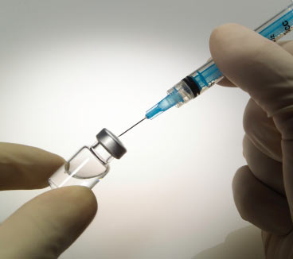
Vaccination/Immunization
-Weakened or inactive form of pathogen injected
-Activates specific immunity without getting sick

Slide 21
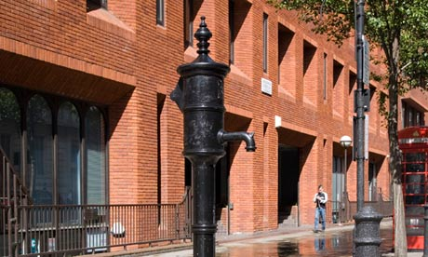
Public Health and Medications
Better public health in modern times
Antibiotics
Antivirals

