Slide 1
Dermis

Slide 2
Fun facts
0.5 mm to 3 mm thick!
It is made up of:
Loose/areolar
Dense irregular
2 regions: papillary and reticular

Slide 3
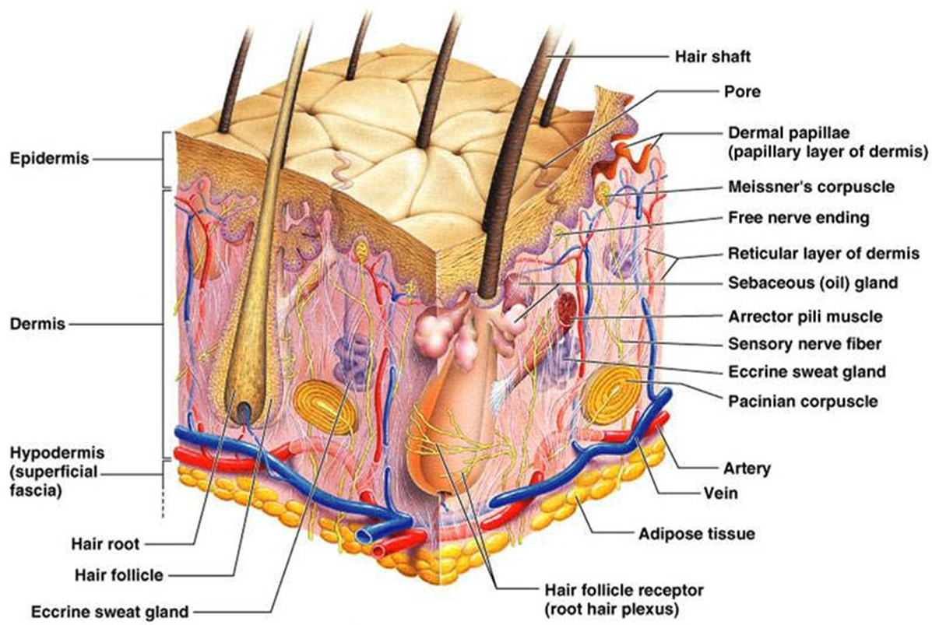

Slide 4
Papillary region
Named for the dermal papillae- projections that stick into the epidermis
Increase contact between epidermis and dermis to connect the layers
Houses sensory receptors

Slide 5
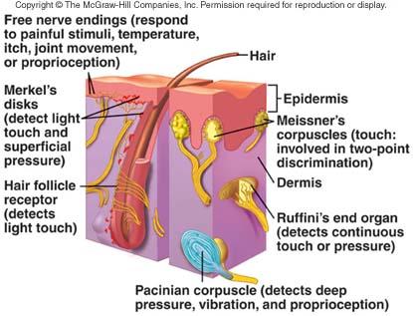
Sensory receptors
Pacinian corpuscle- detects deep, heavy pressure
Meissner’s corpuscle- detects light touch

Slide 6
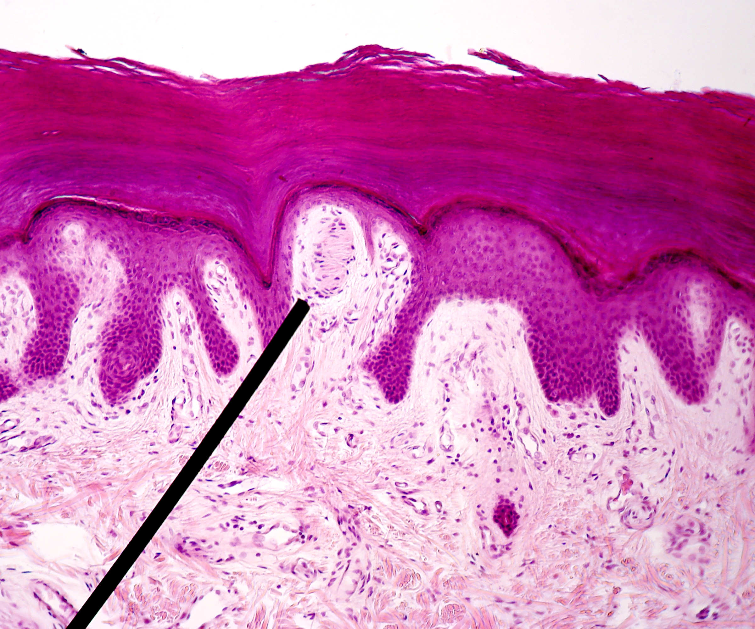

Slide 7
Reticular layer
Reticular= “network”
Has large bundles of collagen fibers

Slide 8
Stretch marks, wrinkles, and lines of cleavage
Collagen and elastic fibers in the dermis give skin its appearance
When skin is stretched beyond capacity, collagen fibers are torn
Lines of cleavage

Slide 9
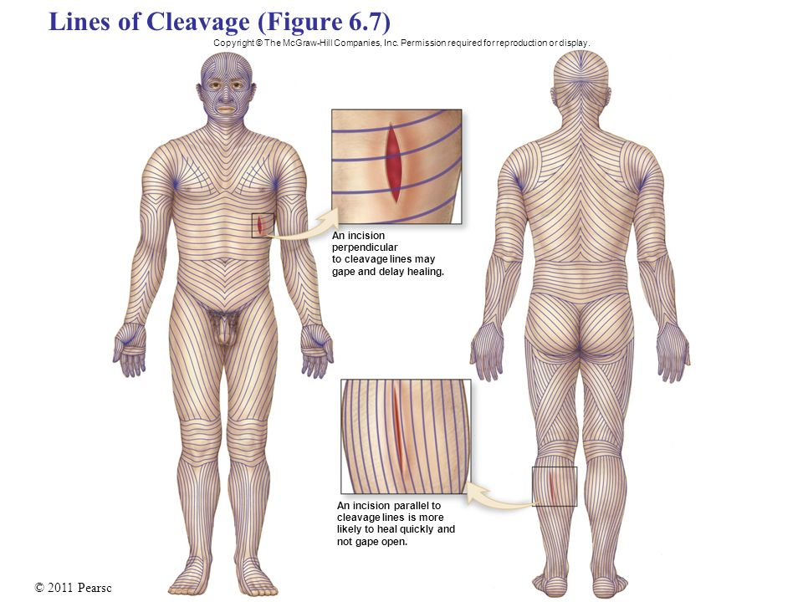

Slide 10
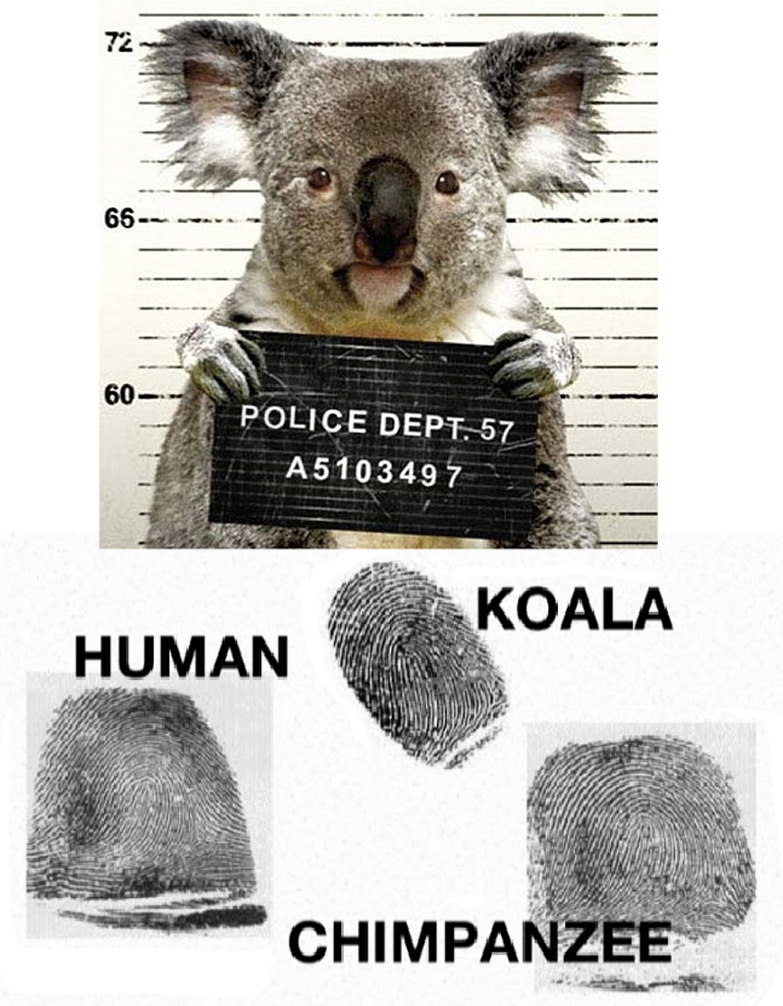
Dermis and fingerprints
Dermal papillae make the friction ridges that collectively make your fingerprints
How determined
Identical twins have unique fingerprints!

