Slide 1
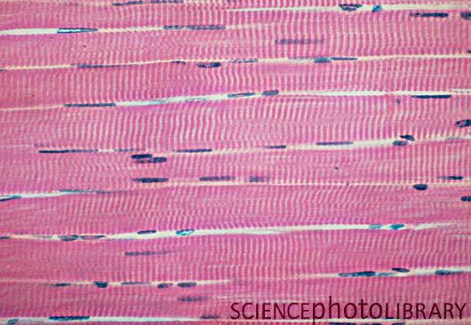
Daily Warm-up Thursday, October 30th
What is the type of tissue?
HW:
-Read the section on connective tissue (pg. 141-148)
-Cell project

Slide 2
Connective Tissues
General characteristics:
Most abundant tissue type
Many functions:
Bind structures
Provide support and protection
Serve as frameworks
Fill spaces
Store fat
Produce blood cells
Protect against infections
Help repair tissue damage
Have a matrix
In between cells – fibrin, collagen, etc
Have varying degrees of vascularity
Have cells that usually divide

Slide 3
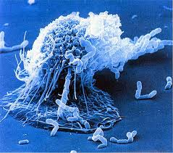
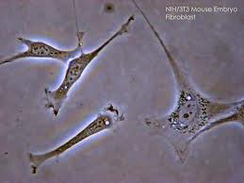
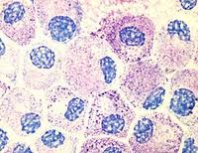
Major Cell Types Present
Fibroblasts
Fixed cell
Most common cell
Large, star-shaped
Produce fibers
Macrophages
Wandering cell
Phagocytic
Important in injury or infection
Mast cells
Fixed cell
Release heparin
Release histamine

Slide 4
Fiber Types Present
Collagenous fibers
Thick
Composed of collagen
Great tensile strength
Abundant in dense CT
Hold structures together
Tendons, ligaments
Elastic fibers
Bundles of microfibrils embedded in elastin
Fibers branch
Elastic
Vocal cords, air passages
Reticular fibers
Very thin collagenous fibers
Highly branched
Form supportive networks

Slide 5
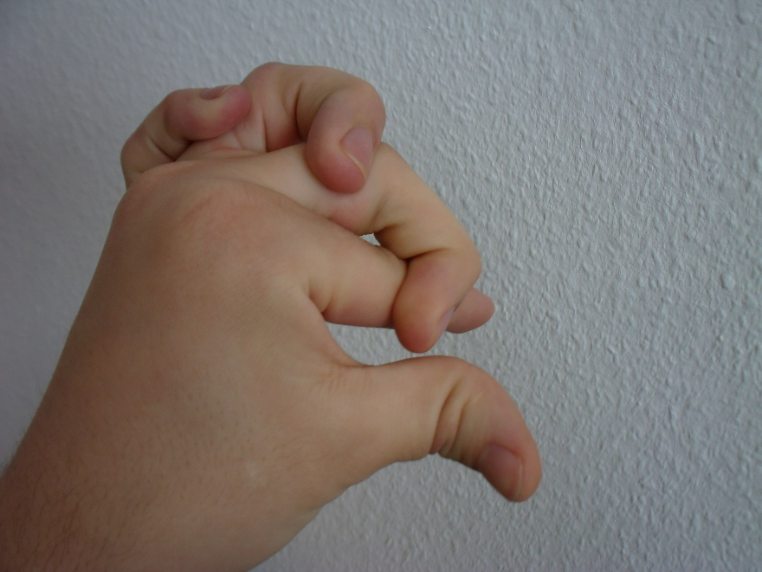
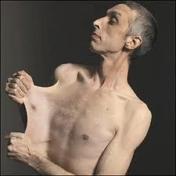

Slide 6
2 Main Connective Tissue Groups
Connective Tissue Proper:
Loose connective tissue
Adipose tissue
Reticular connective tissue
Dense connective tissue
Elastic connective tissue
Specialized Connective Tissue:
Cartilage
Bone
Blood

Slide 7
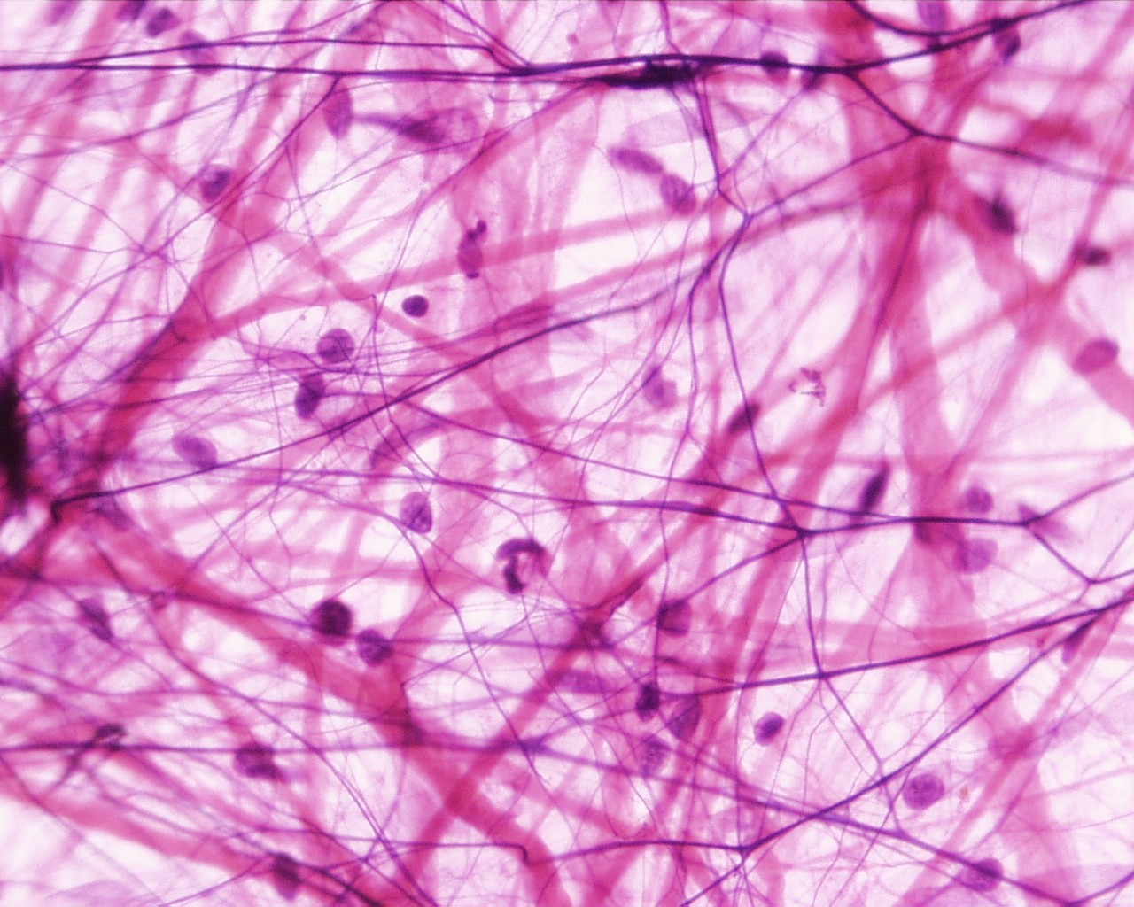
Loose Connective Tissue/Areolar
Loose Connective Tissue
Mainly fibroblasts
Fluid to gel-like matrix
Collagenous fibers
Elastic fibers
Bind skin to structures
Beneath most epithelia
Blood vessels nourish nearby epithelial cells
Between muscles
Copyright © The McGraw-Hill Companies, Inc. Permission required for reproduction or display.
(
(b)

Slide 8
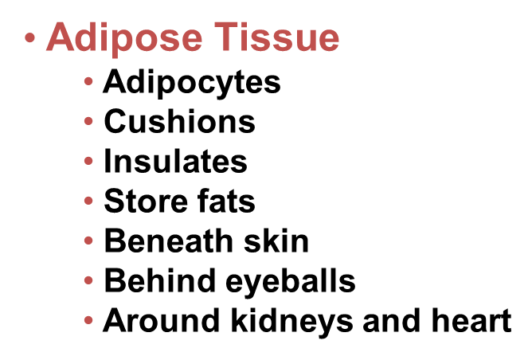
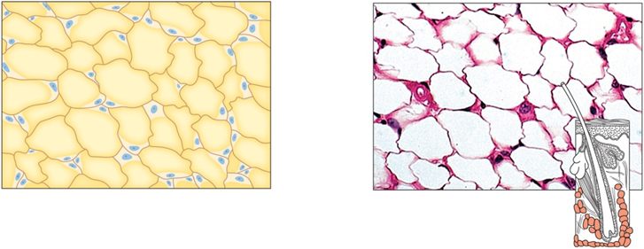

Slide 9
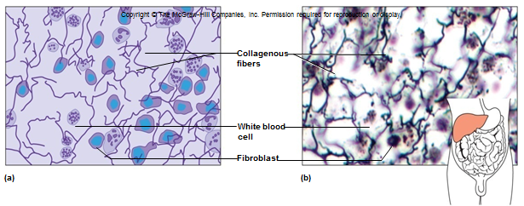

Slide 10
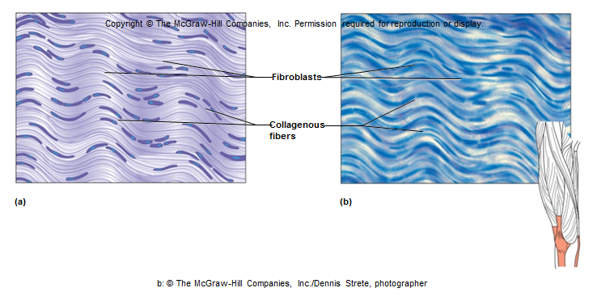
Dense Connective Tissue
Packed collagenous fibers
Elastic fibers
Few fibroblasts
Bind body parts together
Tendons, ligaments, dermis
Poor blood supply
Copyright © The McGraw-Hill Companies, Inc. Permission required for reproduction or display.
Fibroblasts
Collagenous
fibers
(a)
(b)
b: © The McGraw-Hill Companies, Inc./Dennis Strete, photographer

Slide 11
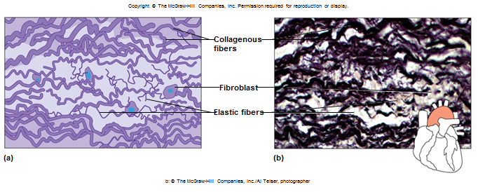
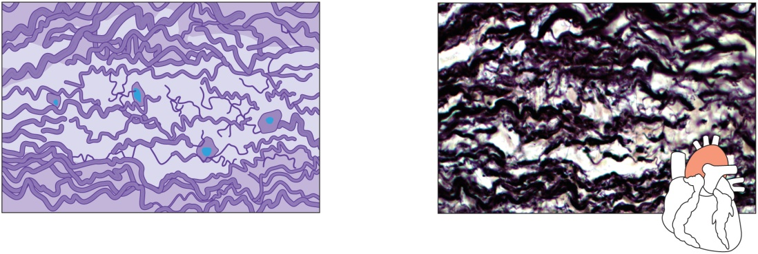
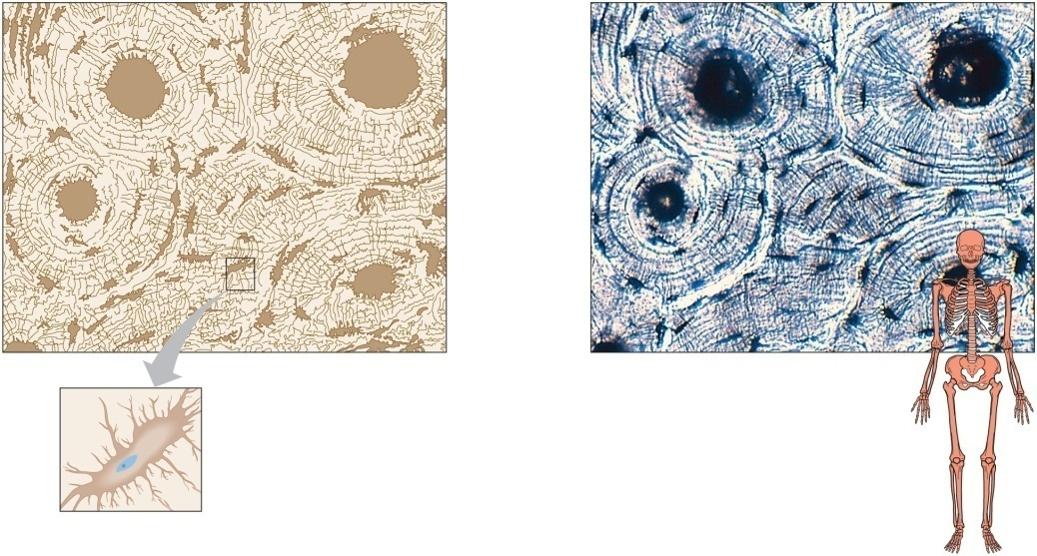
Elastic Connective Tissue
Abundant in elastic fibers
Some collagenous fibers
Fibroblasts
Attachments between bones
Walls of large arteries, airways, heart
Copyright © The McGraw-Hill Companies, Inc. Permission required for reproduction or display.
Copyright © The McGraw-Hill Companies, Inc. Permission required for reproduction or display
Collagenous
fibers
Osteon
Lamella
Fibroblast
Elastic fibers
Central canal
Osteocyte in lacuna
(a)
(b)
Canaliculi
b: © The McGraw-Hill Companies, Inc./Al Telser, photographer
(a)
(b)
Osteocyte
Nucleus
21
Cell process in canaliculus
b: © The McGraw-Hill Companies, Inc./Dennis Strete, photographer

Slide 12
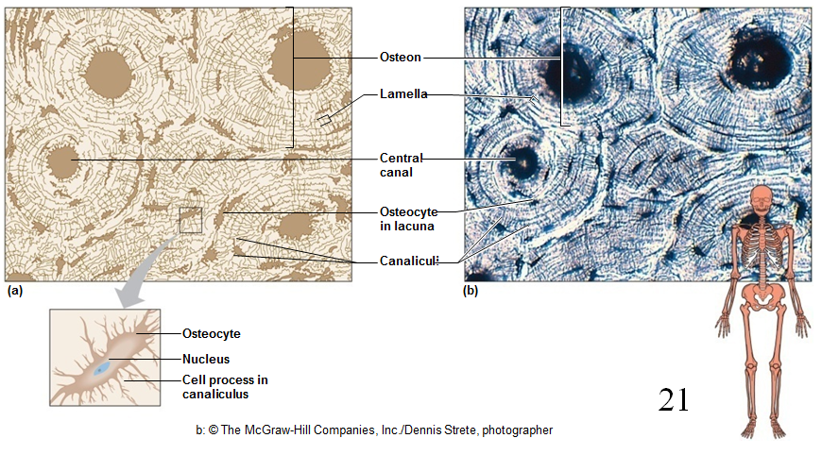

Slide 13
Elastic connective tissue
Osseous / Bone tissue

Slide 14
Cartilage
Hyaline cartilage
Most abundant
Ends of bones
Nose, respiratory passages
Embryonic skeleton
Cartilage
Rigid matrix
Chondrocytes in lacunae
Poor blood supply
Three (3) types:
Hyaline Cartilage
Elastic Cartilage
Fibrocartilage
Elastic cartilage
Flexible
External ear, larynx
Fibrocartilage
Very tough
Shock absorber
Intervertebral discs
Pads of knee and pelvic girdle

Slide 15
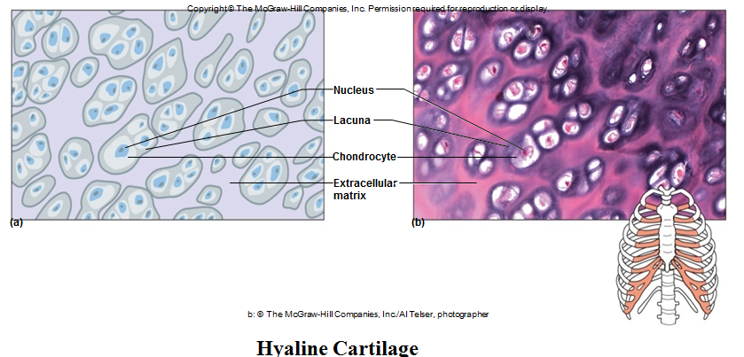

Slide 16
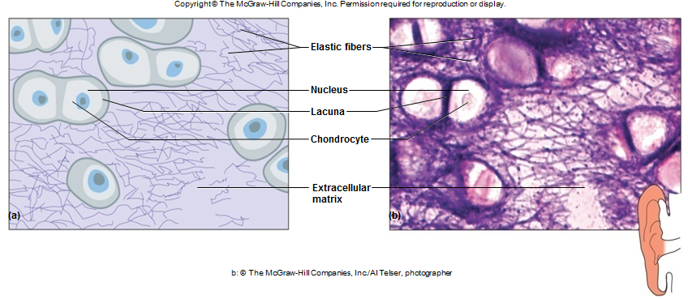

Slide 17
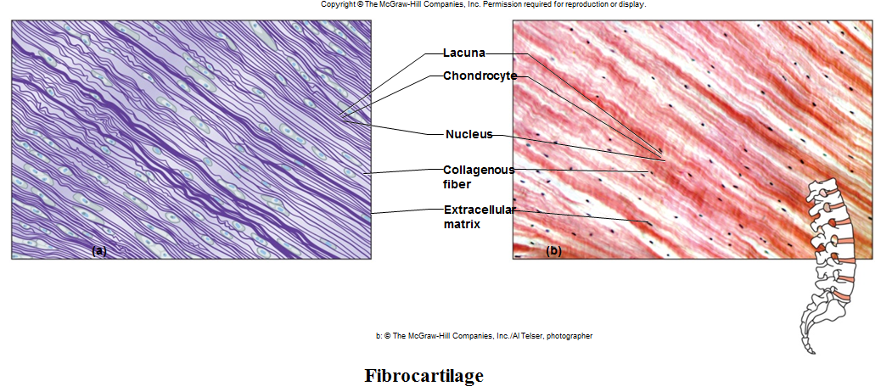

Slide 18
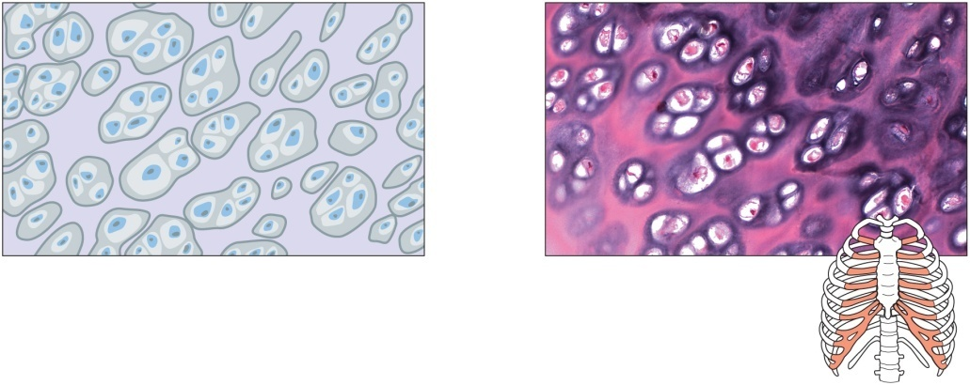
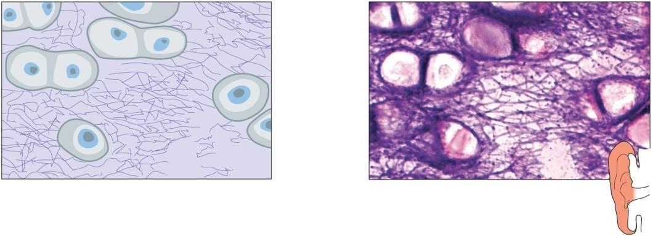
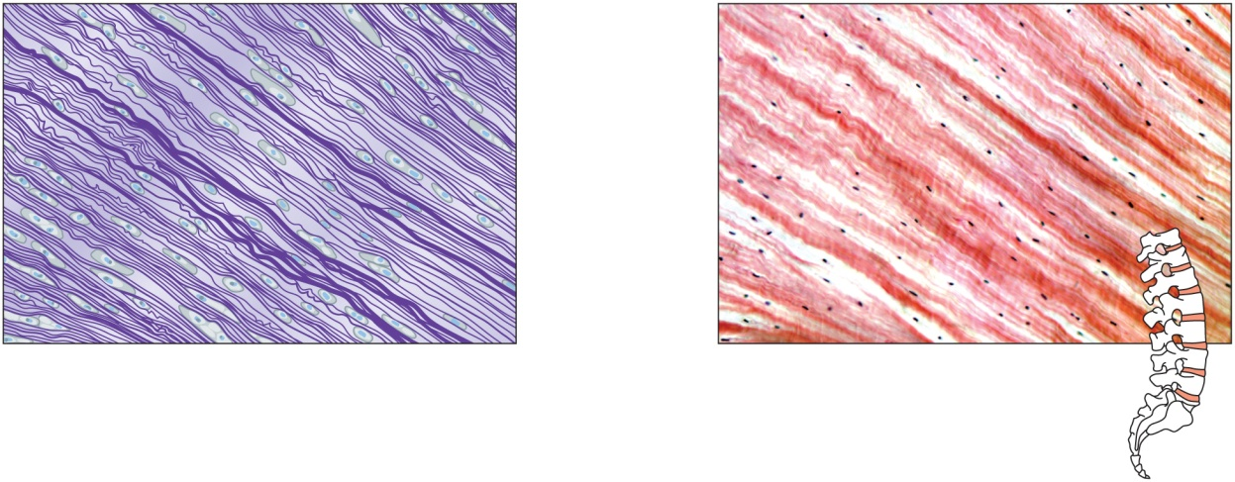
Three (3) types of cartilage:
Copyright © The McGraw-Hill Companies, Inc. Permission required for reproduction or display.
Copyright © The McGraw-Hill Companies, Inc. Permission required for reproduction or display.
Elastic fibers
Nucleus
Nucleus
Lacuna
Lacuna
Chondrocyte
Chondrocyte
Extracellular
matrix
(a)
(b)
Extracellular
matrix
(a)
(b)
b: © The McGraw-Hill Companies, Inc./Al Telser, photographer
b: © The McGraw-Hill Companies, Inc./Al Telser, photographer
Hyaline Cartilage
Elastic Cartilage
Copyright © The McGraw-Hill Companies, Inc. Permission required for reproduction or display.
Lacuna
Chondrocyte
Nucleus
Collagenous
fiber
Extracellular
matrix
(a)
(b)
b: © The McGraw-Hill Companies, Inc./Al Telser, photographer
Fibrocartilage

Slide 19
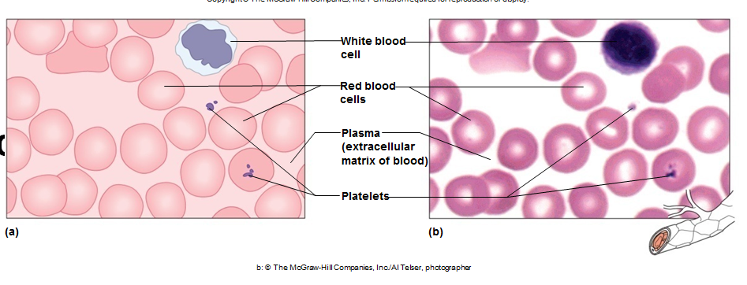
Blood
Fluid matrix called plasma
Red blood cells
White blood cells
Platelets
Transports
Defends
Involved in clotting
Throughout body in blood vessels
Heart

Slide 20
Quiz!
Tissue that stores fat is called ______ tissue.
Epithelial
Adipose
3. Reticular

Slide 21
Tendons and ligaments are what type of connective tissue?
Dense connective tissue
Osseous tissue
Cartilage tissue

