Slide 1
Daily Warm-up Thursday, November 14th
What causes goose bumps?
HW:
-Read pg. 173-175
-Have burns worksheet completed by Monday

Slide 2
Burns
Caused by radiation, sun, boiling water, chemicals, fire, electricity
3 types
RULE OF NINES – Measures percent of body
burned. Body divided into 11 areas, each is 9% of
body surface

Slide 3
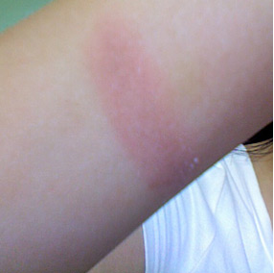
First Degree burn
Superficial
Skin red and dry
Involves only epidermis
Rx- cold water
Healing within one week

Slide 4
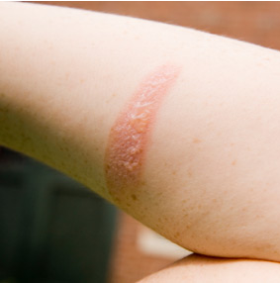
Second Degree burn
Epidermis and dermis
Pain, swelling, redness, and blistering
Skin may be exposed to infection
Rx- pain medication, dry sterile dressing
Healing within 2 weeks

Slide 5
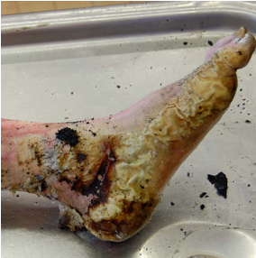
Third Degree burn
Epidermis, dermis, and subcutaneous layers
Symptoms- loss of skin, blackened skin
May be life-threatening
Nerve damage

