Slide 1
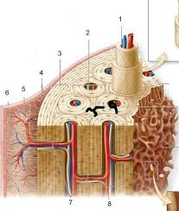
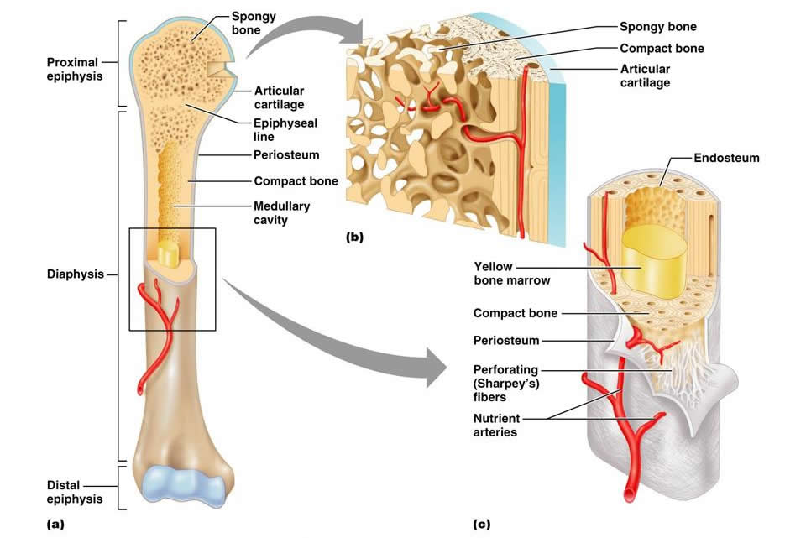
Skeletal System: Bone anatomy and microstructure

Slide 2
Introduction to Skeletal System
# of bones in adults vs. infants
206 and 300
Functions: support, protection, movement, hemopoiesis, storage of minerals (calcium and phosphate)
Compact vs. spongy (cancellous) bone

Slide 3
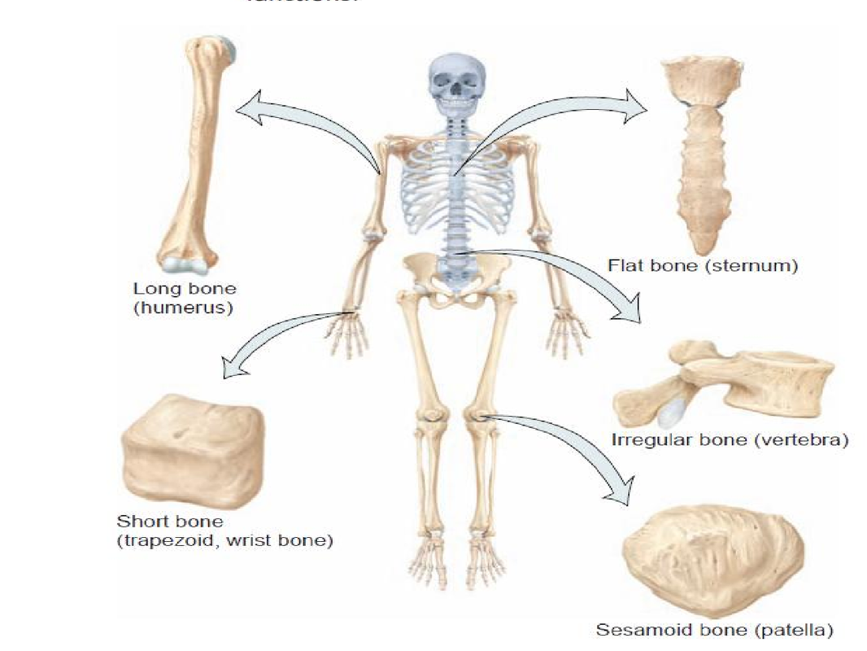
Introduction Continued
4 categories of bones:
Long, short, flat, irregular

Slide 4
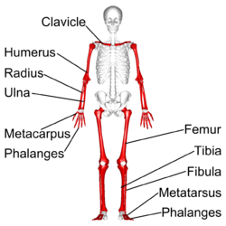
Long bones
Greater length than width
Most common bone shape
Labeling terms

Slide 5
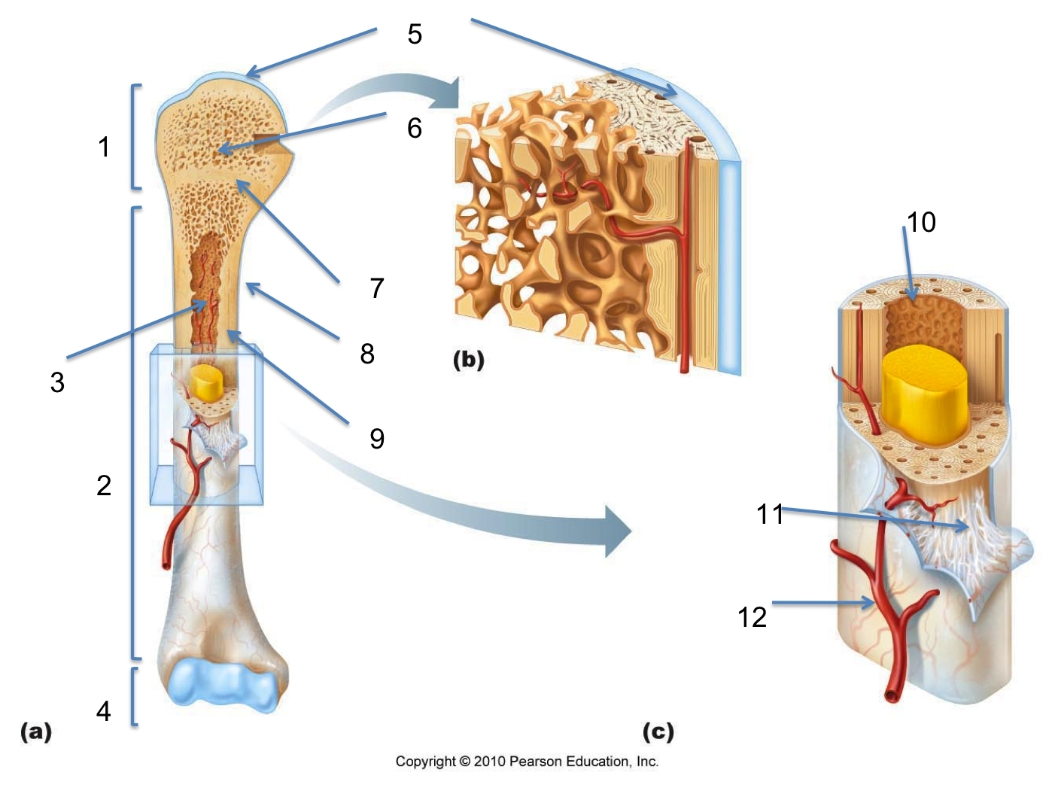
Long Bone Labeling

Slide 6
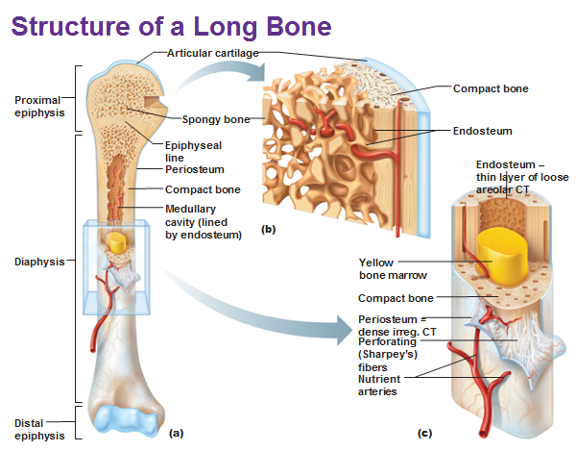

Slide 7
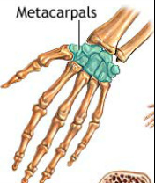
Short Bones
Have length nearly equal to width
Ex. carpals, tarsals, patella

Slide 8
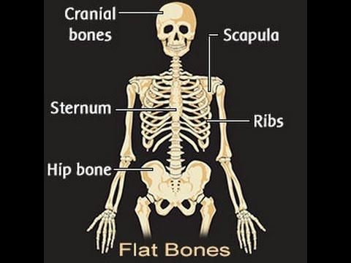
Flat Bones
Flat, thin surfaces
Provide surface for muscle attachment
Ex. skull bones, scapulae, sternum, and ribs

Slide 9
Irregular Bones
Do not fit into the other categories
Ex. os coxae, vertebrae

Slide 10
Compact vs. Spongy/cancellous bone

Slide 11
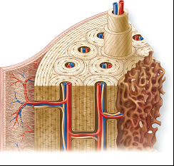
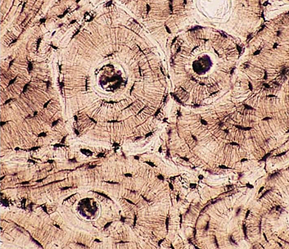
Compact Bone Anatomy

