Slide 1
Body Planes

Slide 2
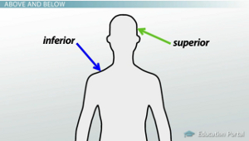
Directional Terms
Superior- Toward the head end or upper part of a structure or the body
Inferior- Away from the head end or toward the lower part of a structure or the body

Slide 3
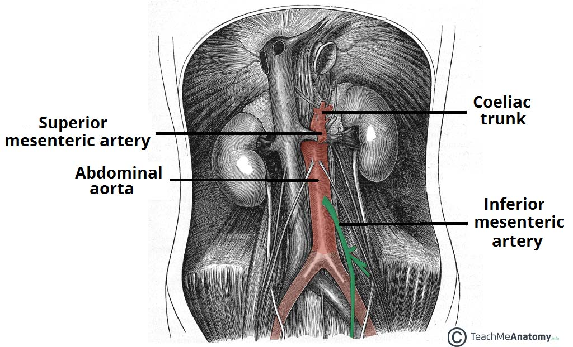

Slide 4
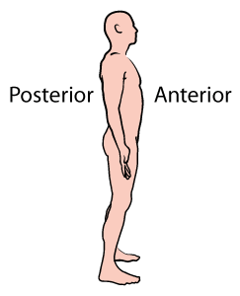
Directional Terms
Anterior- Toward or at the front of the body (ventral)
Posterior- Toward the back of the body; behind (dorsal)

Slide 5
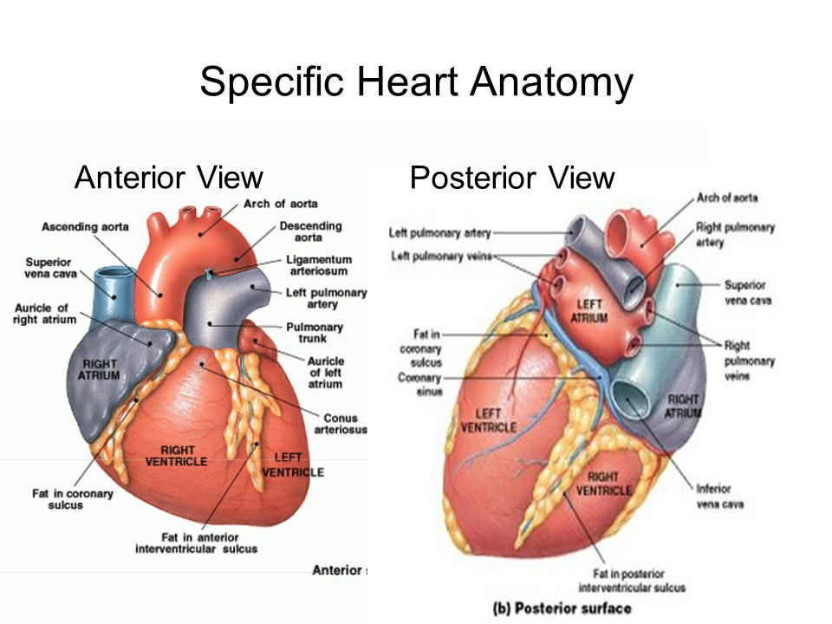

Slide 6
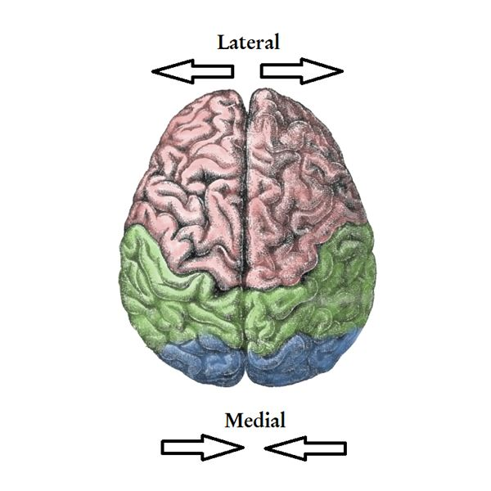
Directional Terms
Medial- toward the mid-line of the body
Lateral- away from the mid-line

Slide 7
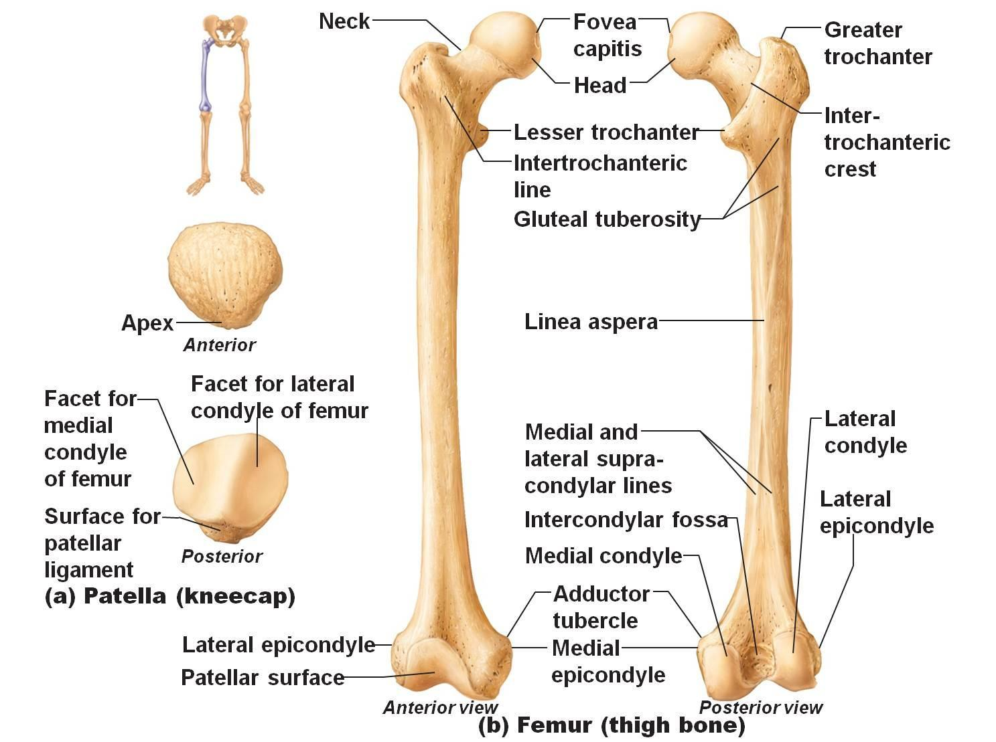

Slide 8
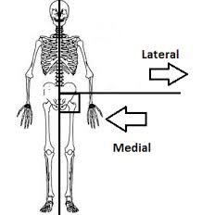
Medial vs. Lateral

Slide 9
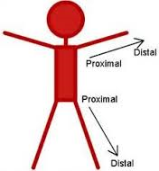
Proximal vs. Lateral
Proximal- closer to the trunk
Distal- further away from the trunk

Slide 10
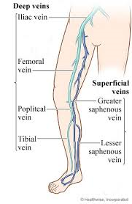
Superficial vs. Deep
Superficial/peripheral: closer to the skin’s surface
Deep- away from skin

Slide 11
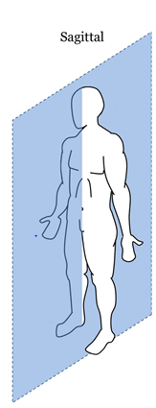
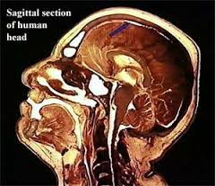
Body Sections
Sagittal: left and right sections

Slide 12
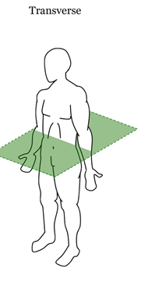
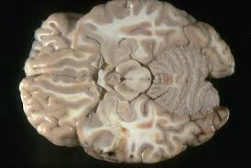
Transverse
Cut into upper and lower halves

Slide 13
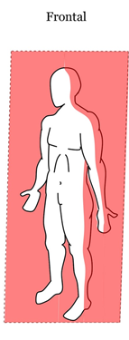
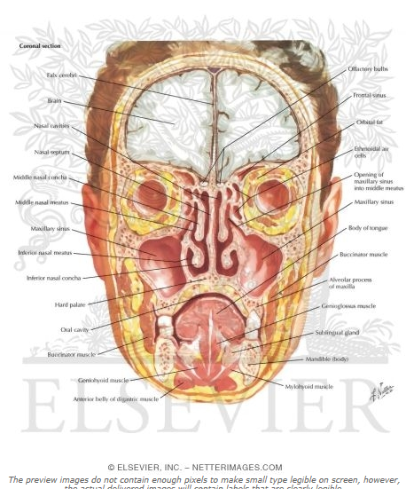
Frontal or coronal
Divided into anterior (front) and posterior (back) portions

Slide 14
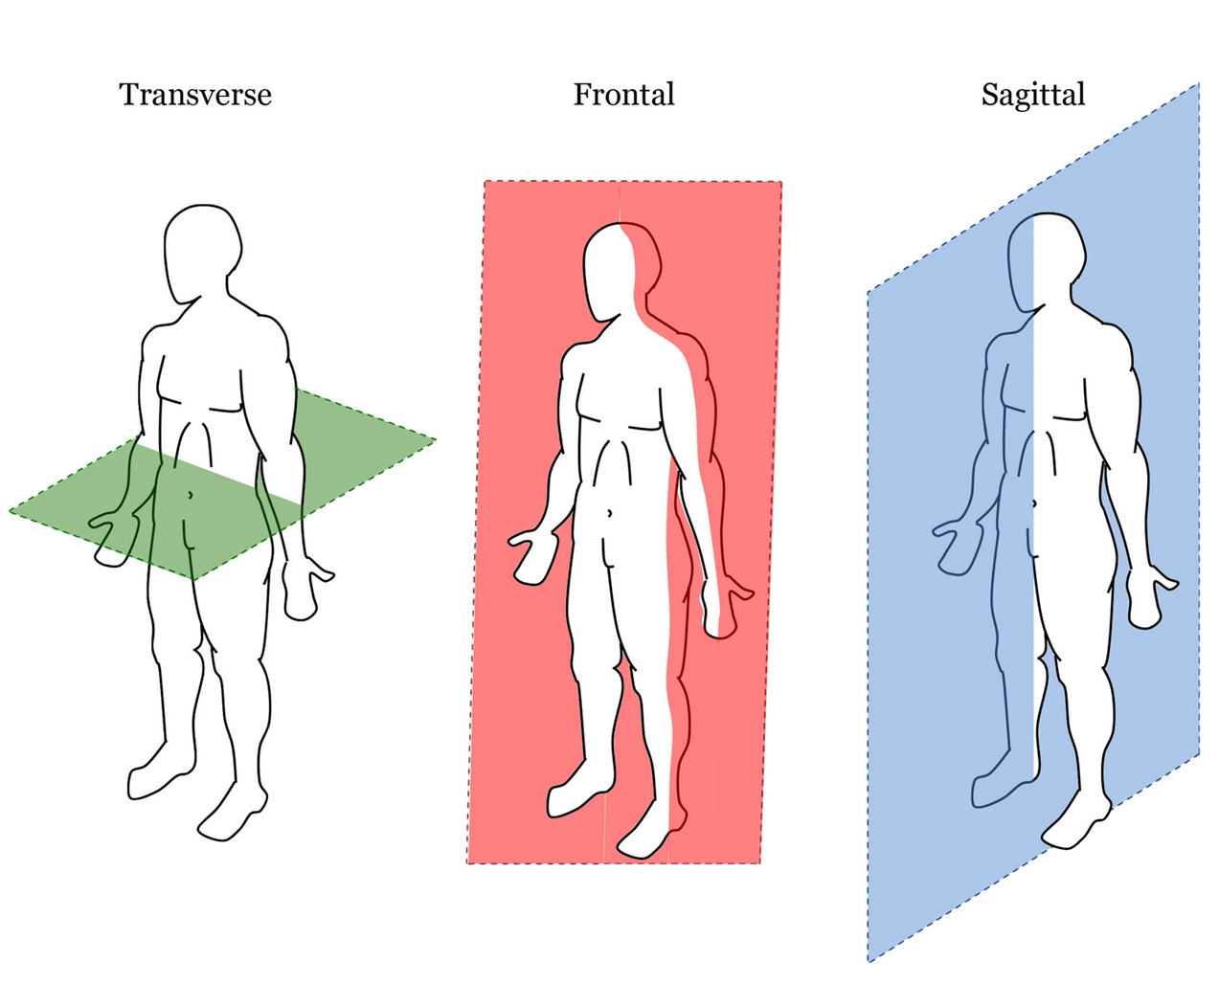

Slide 15
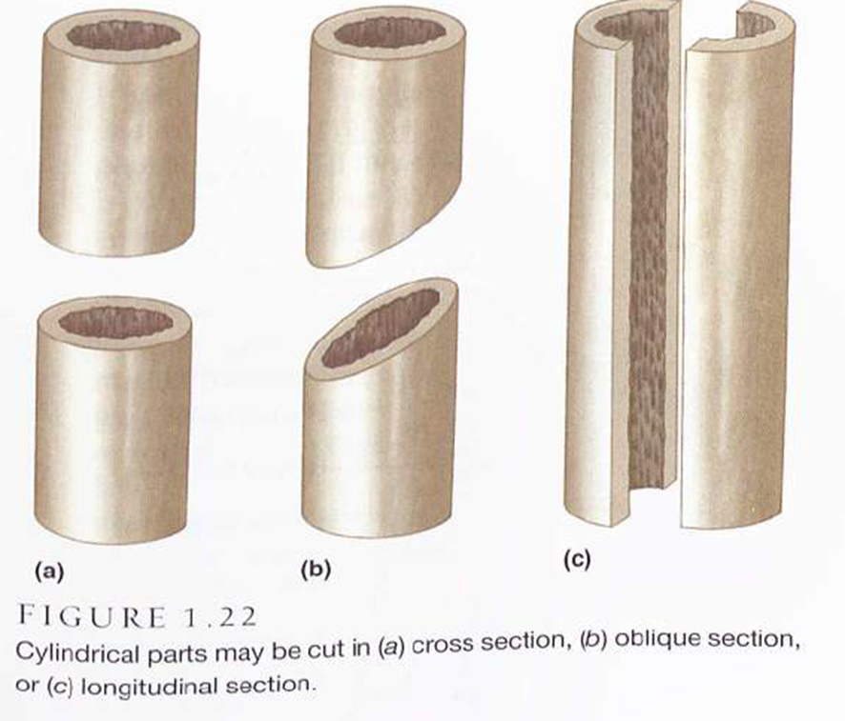

Slide 16
Try it!
In pairs, identify the following areas on a partner:
Area distal to the knee
Area proximal to the elbow
Lateral to the big toe
Anterior side of the body
Posterior side of the body
Area that is medial to the shoulder
Area that is superior to the lungs
Area that is inferior to the heart

Slide 17
Abdominal Regions & Quadrants

Slide 18
Abdominal Regions & Quadrants

Slide 19
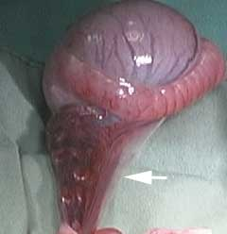
Serous Membranes (Epithelial)
Line body cavities that do not open directly to the outside
Cover the organs located in those cavities.
Fluid lubricates the membrane and reduces friction and abrasion when organs move against each other.
Canine Reproductive Organs

Slide 20
Serous Membranes cont….
Serous membranes occur in pairs separated by serous fluid
Specific
Peritoneum
Abdominal cavity
Pleura
Around the lungs
Pericardium
Around the heart

