Slide 1
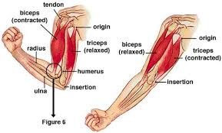
Biceps brachii
Flex the elbow

Slide 2
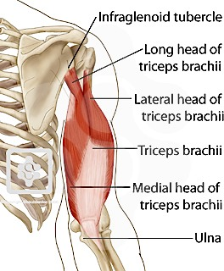
Triceps brachii
Extends arm

Slide 3
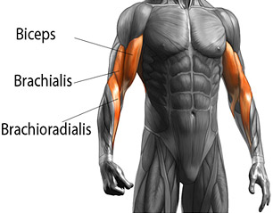
Brachioradialis
Flexes elbow
Supinates and pronates!

Slide 4
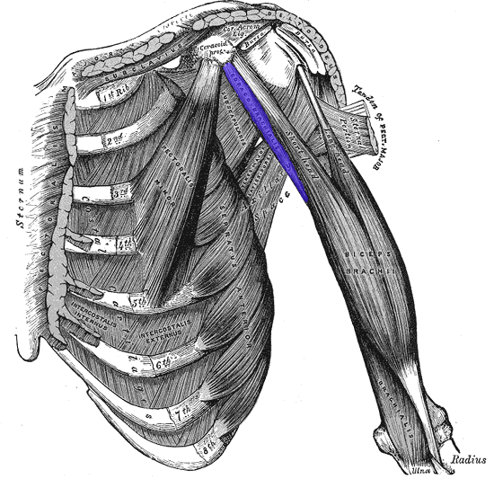
Coracobrachialis
Adduct

Slide 5
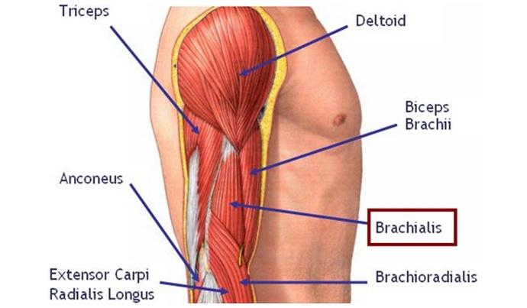
Brachialis
Flexes arm

Slide 6
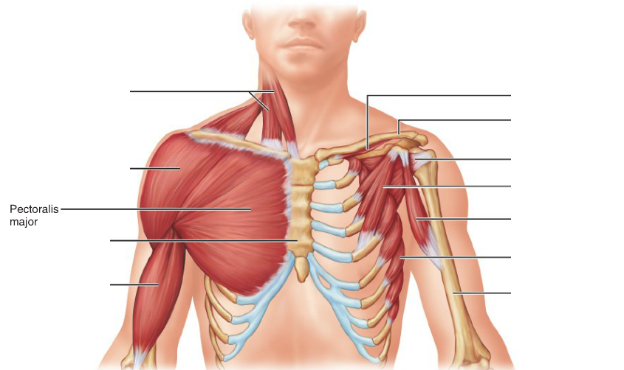
Pectoralis major

Slide 7
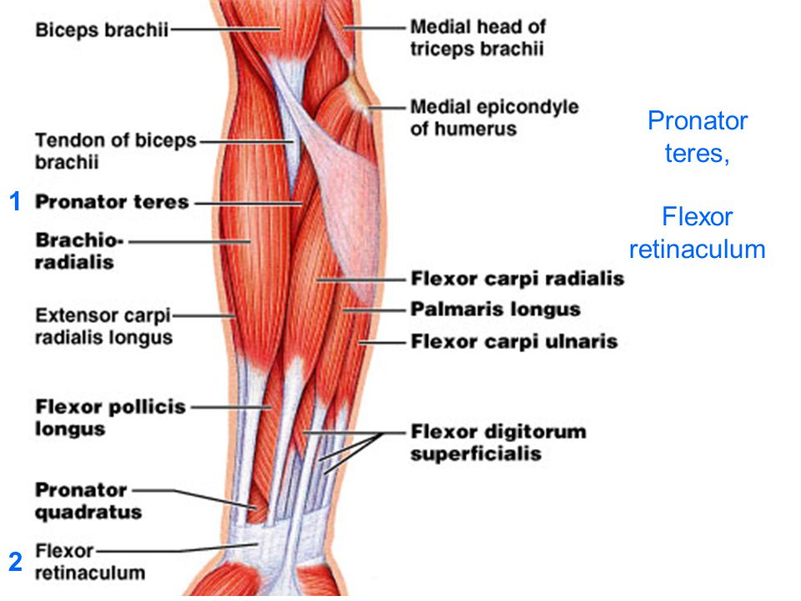
Pronator Teres

Slide 8
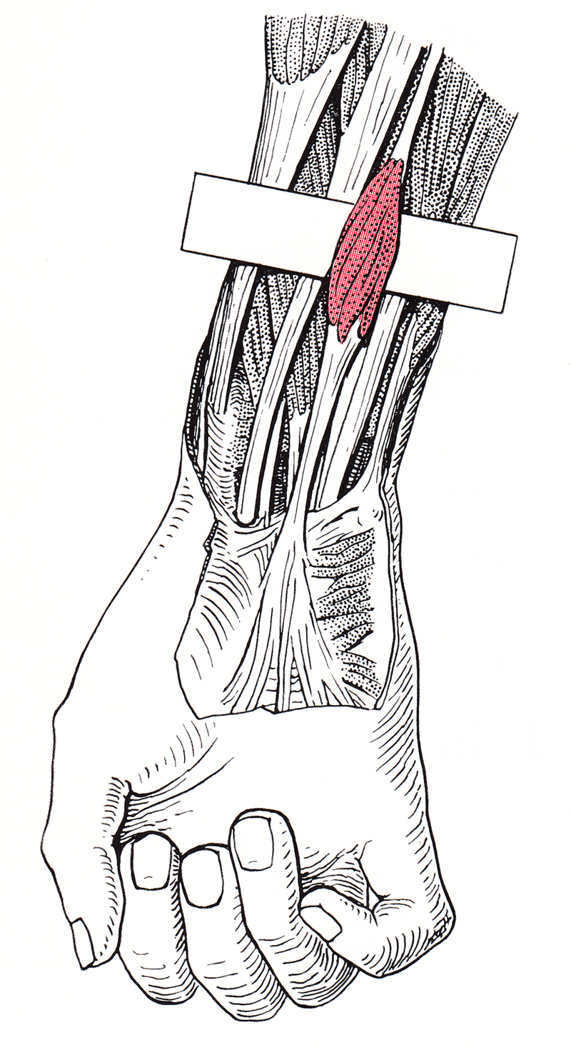
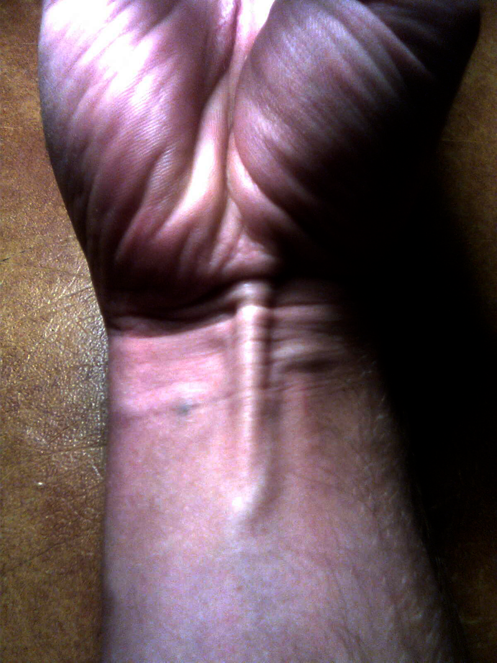
Palmaris longus
Wrist flexor
Sometimes absent

Slide 9
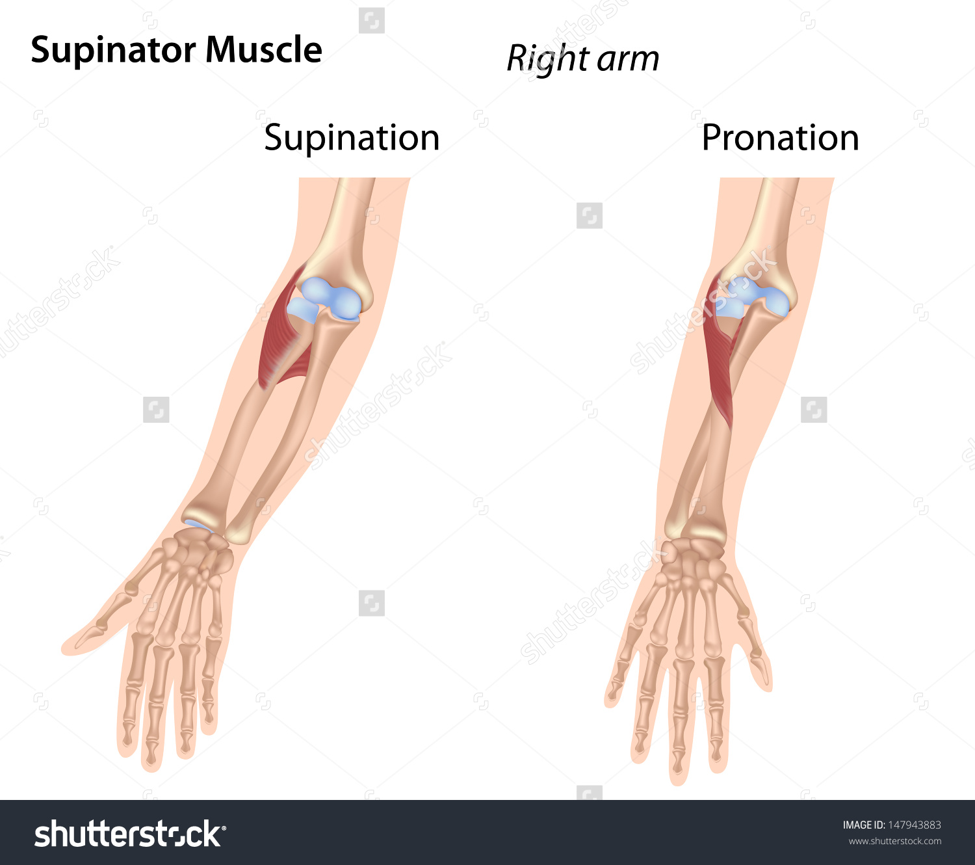
Supinator

Slide 10
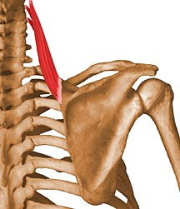
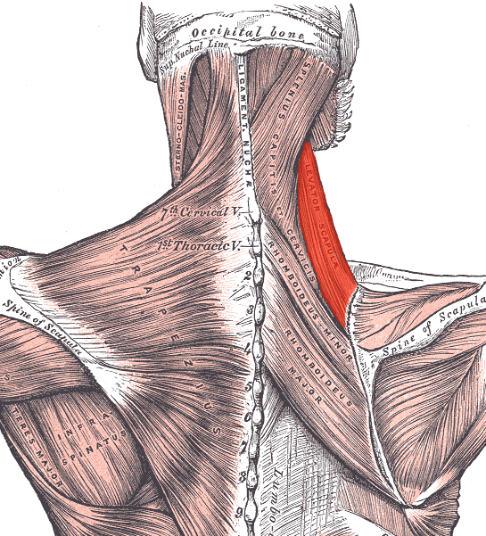
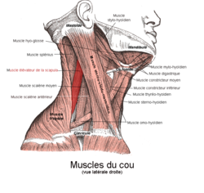
Levator scapulae
What do you think it is responsible for?

Slide 11
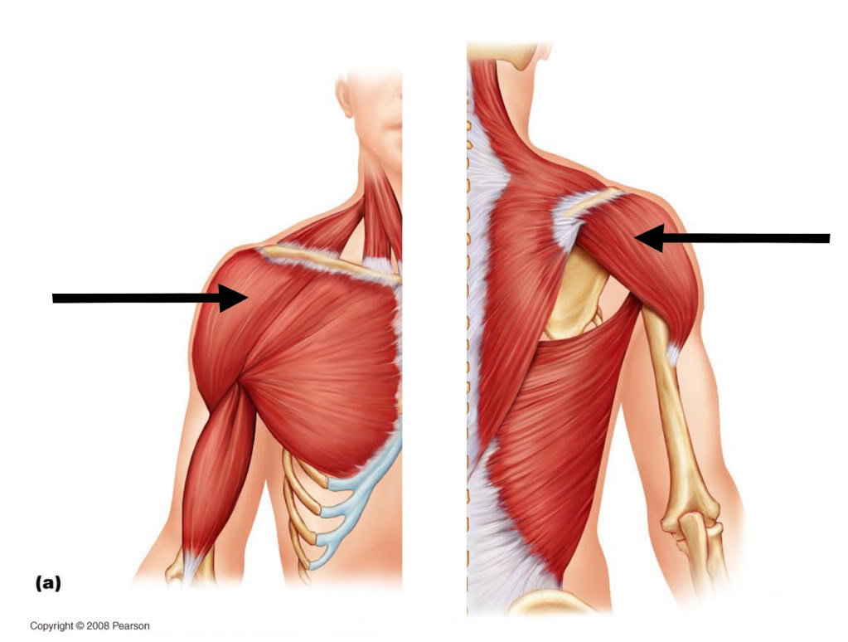
Deltoid
Abducts the arm

Slide 12
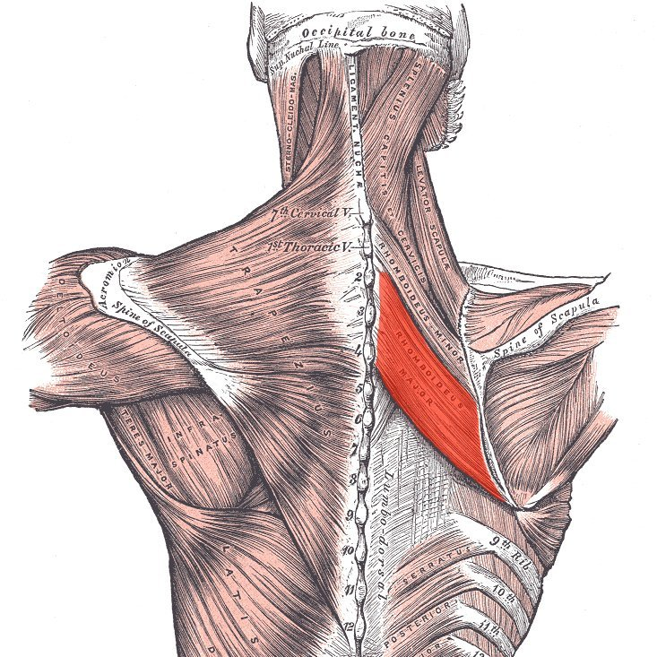
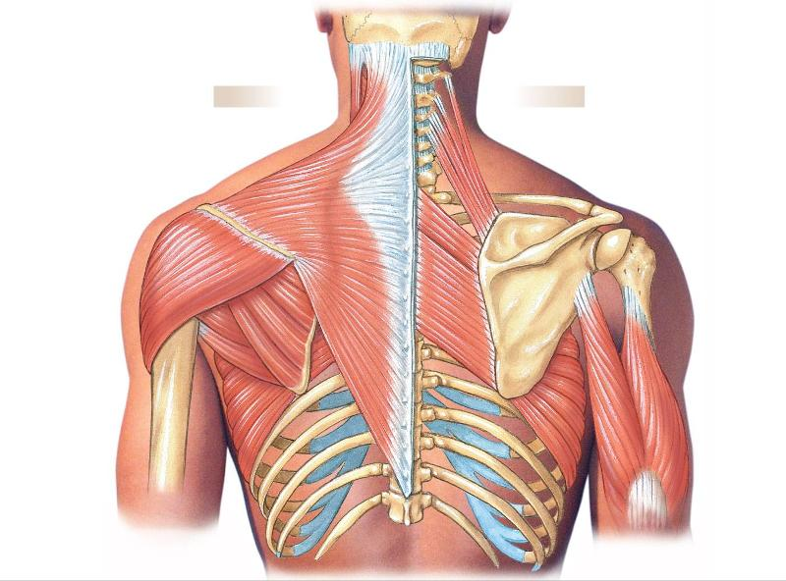
Rhomboid major
Retracts scapula toward vertebral column

Slide 13
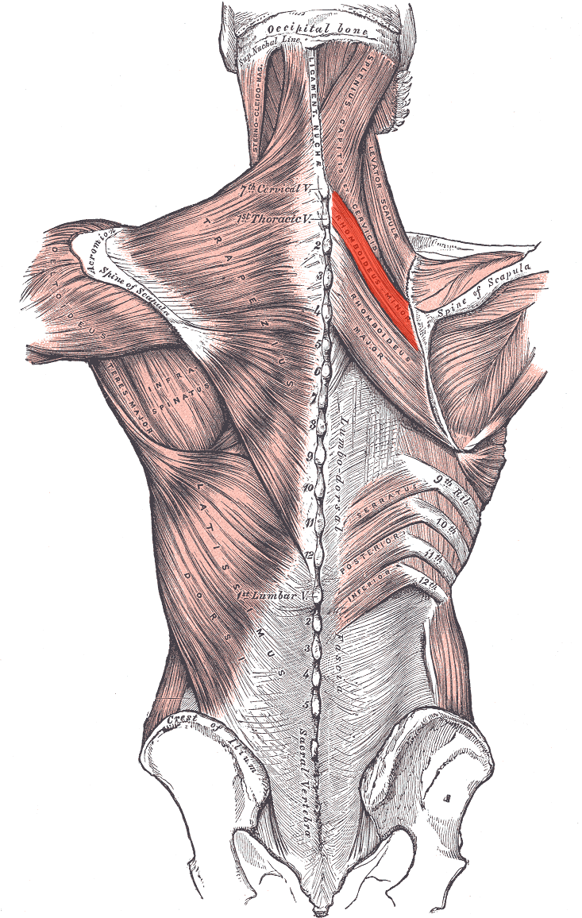
Rhomboid Minor
Retracts scapula

Slide 14
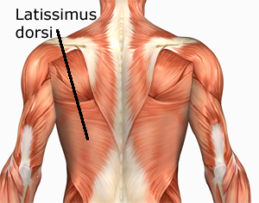
Latissimus dorsi

Slide 15
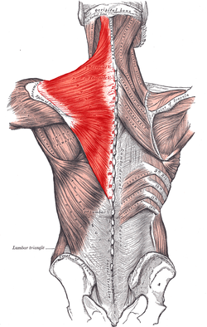
Trapezius
Moves the shoulder
-Retracts
-Depresses

Slide 16
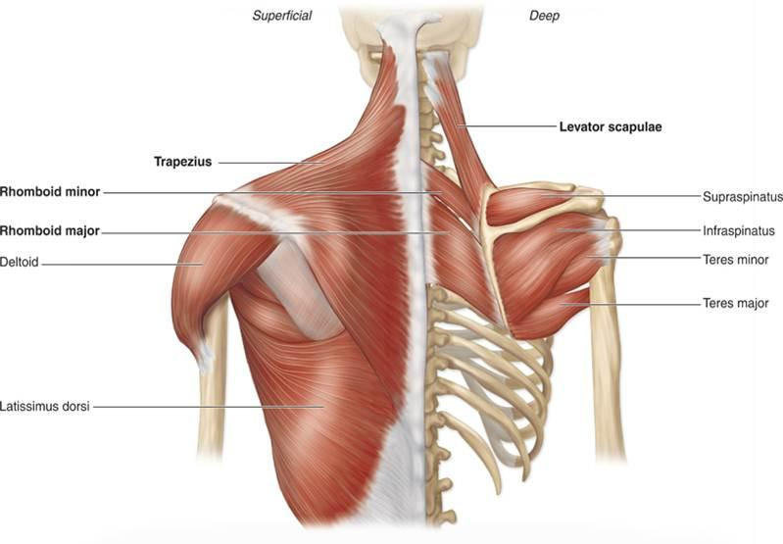
Teres major and minor
Adductor of humerus
Medial rotates humerus

Slide 17
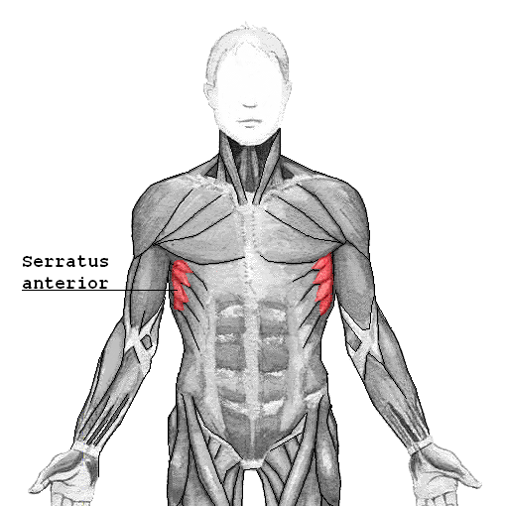
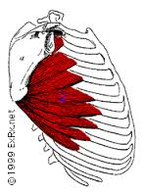
Serratus anterior
“Boxer’s muscle”
Protraction of scapula

Slide 18
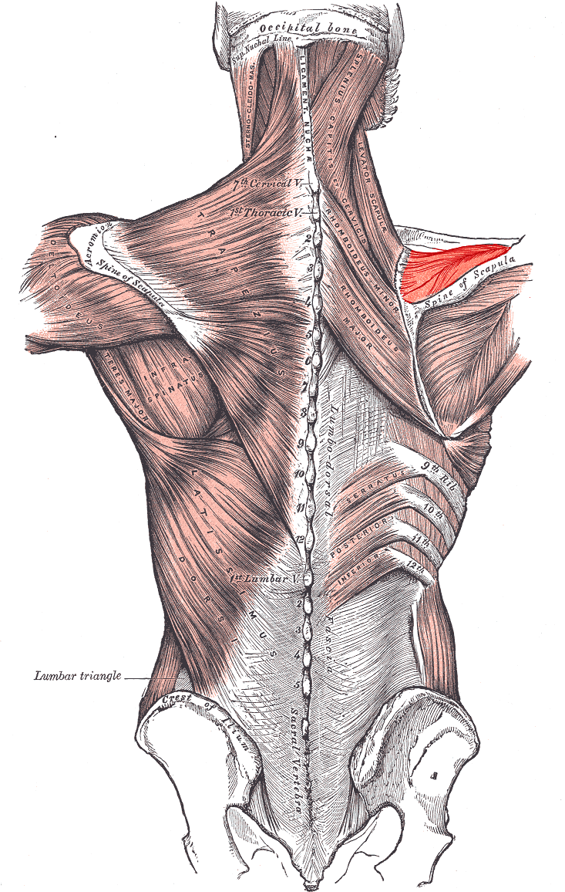
Supraspinatus
Abducts arm

Slide 19
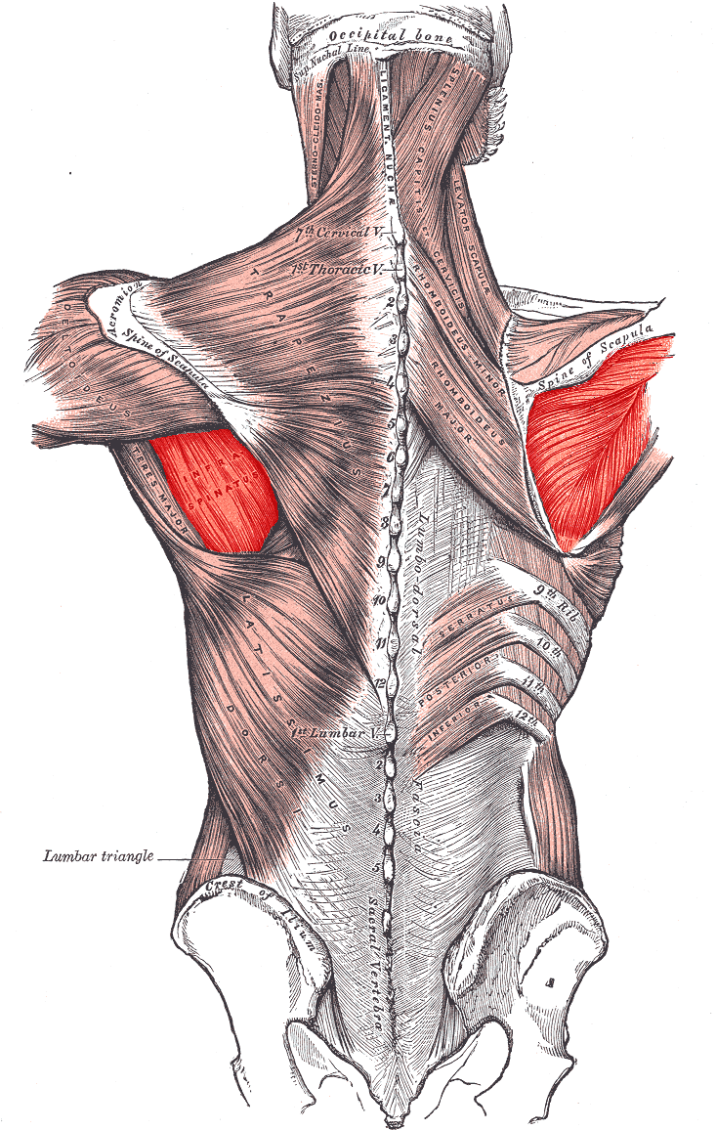
Infraspinatus
Rotates shoulder
Abducts arm

Slide 20
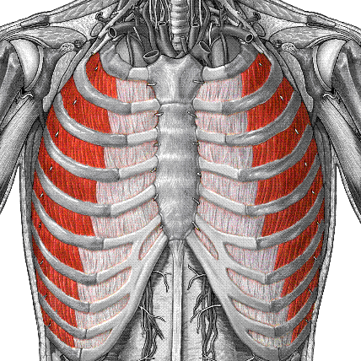
Intercostals
Help facilitate breathing

Slide 21
