Slide 1
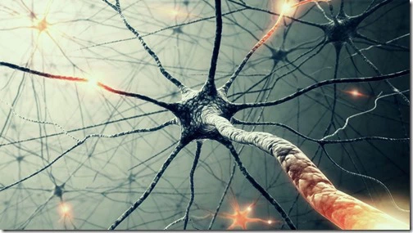
Action Potential

Slide 2
Resting Potential
Neuron is negative in relation to the outside environment
Due to imbalance of ions
Where does the negative charge come from?
High amounts of potassium inside, high amounts of sodium in the extracellular environment.
Very few sodium gates!
Negatively charged proteins inside the cell
Sodium-potassium pump
3 sodium out for 2 potassium in

Slide 3
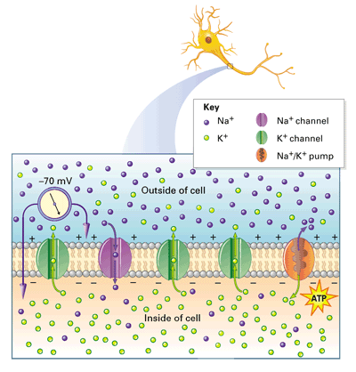

Slide 4
Steps of Action Potential
Neurotransmitter received by receptor in dendrite
Receptor opens
-Sodium flows into the cell
Voltage-gated sodium ion channels open due to the positive charge, allowing more sodium into the cell.
Voltage-gated potassium ion channels open, helping to restore the cell to its negative resting potential
At the axon terminals, voltage-gated calcium ion channels open, calcium enters the cell, triggering exocytosis of vesicles containing neurotransmitters
Neurotransmitters enter the synaptic cleft

Slide 5
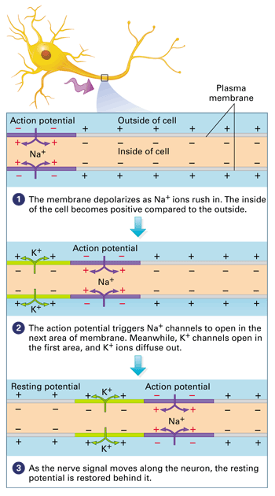

Slide 6
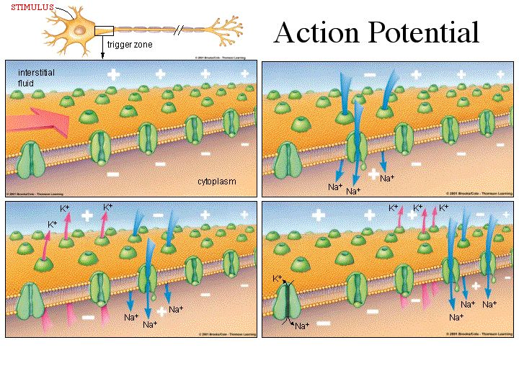

Slide 7
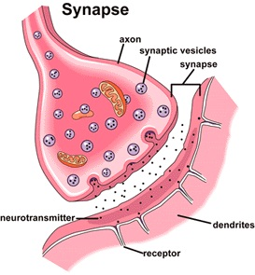

Slide 8
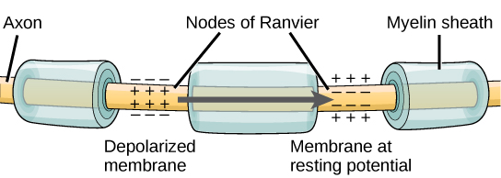
Importance of myelin sheath

Slide 9
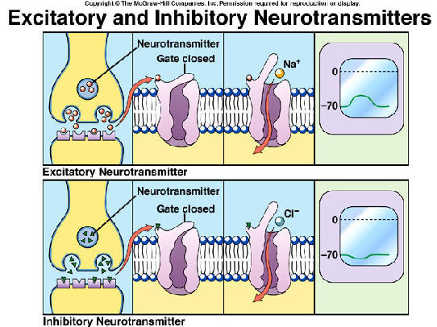
Synaptic Potentials
Excitatory synaptic potentials
Depolarizes neurons
More likely for action potential to occur
Inhibitory synaptic potentials
Hyperpolarizes neurons
Less likely for action potential to occur

