Slide 1
Accessory organs

Slide 2
Accessory organs
Found in the dermis, but extend through the epidermis
Nails, hair, and sweat and sebaceous glands

Slide 3
Nails
Made of keratinized cells
Function- protection

Slide 4
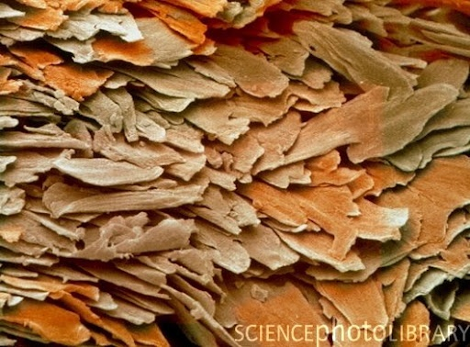

Slide 5
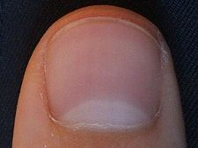
Anatomy
Pink nail body
Free edge
White because no blood vessels
Lunula- proximal white semilunar area
White because thick stratum basale obscures blood vessels

Slide 6
Anatomy Continued
Eponychium (cuticle)- band of epidermis that extends onto the nail body
Nail bed- epidermis that contains the living cell layers
Nail root- proximal end of nail embedded in skin

Slide 7
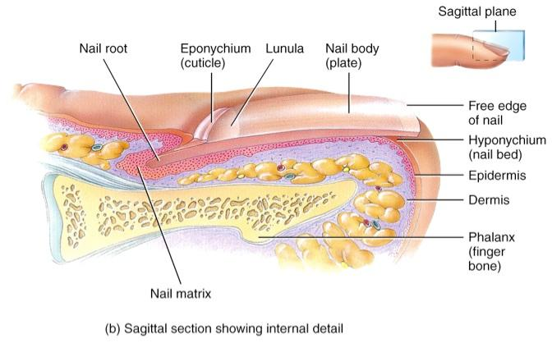

Slide 8
hair
Everywhere on body except a few places
Single hair is called a pilus
Made of keratinized cells
Functions- protection, heat retention, facial expression, sensory, pheromones

Slide 9
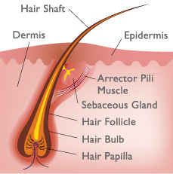

Slide 10
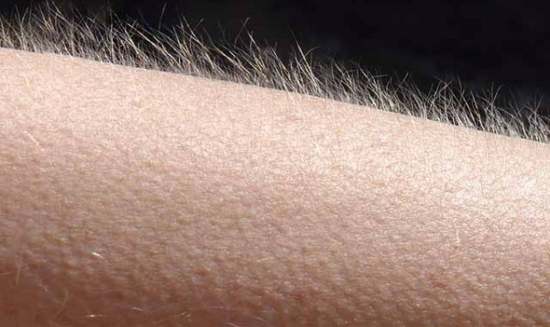

Slide 11
Sweat glands
AKA Sudoriferous gland
Some empty onto hair follicle, others onto the surface of the skin
Functions: thermoregulation, secretion, protection

Slide 12
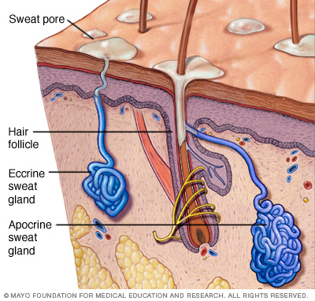

Slide 13
Sebaceous glands
Produce sebum (oil) onto hair follicle
Helps keep hair and skin from becoming dry
Where is there the most?
Issues…

Slide 14
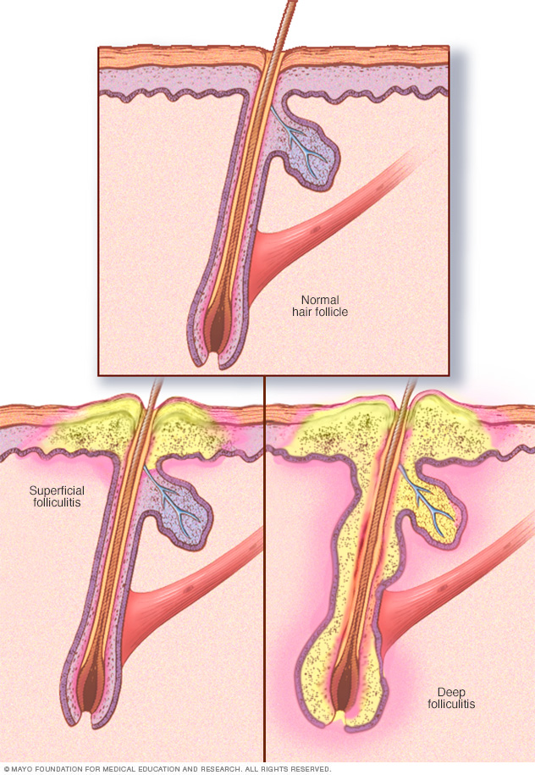

Slide 15
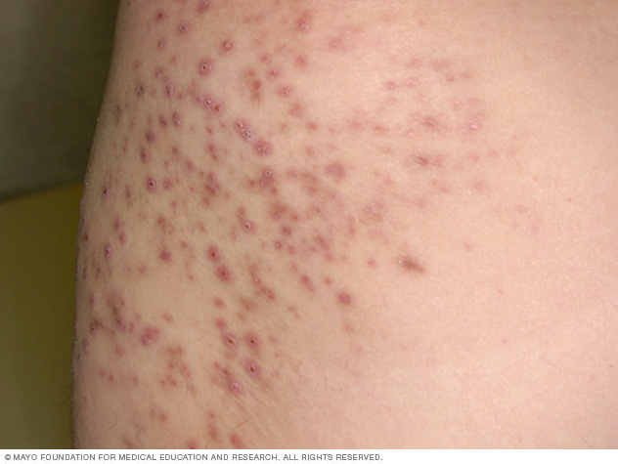

Slide 16
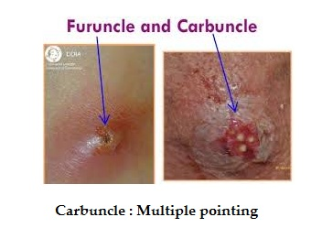

Slide 17
Other integumentary glands
Ceruminous glands- ear wax
Mammary glands
Found in males and females, but only ever active in females

Slide 18
ACNE
Plugged sebaceous duct
Types
Comedo
Blackhead
Whitehead
Papule and pustule
Nodule
Cyst

Slide 19
